Slide 1
App in a Day PowerApps/Flow/CDS Workshop
Bart Sneary – MTC Architect – basneary@microsoft.com
Notes:
Bart : Kickoff & Strategy slides (1-10)

Slide 2
Welcome
Our agenda for the day
AGENDA:
9:00 – 12:00 Power Platform Overview and Hands-On Learning
12:00 – 1:00 Lunch
1:00 – 2:00 CDS Value along with Tips and Tricks
2:00 – 3:00 Build Something Interesting Yourselves
3:00 – 4:30 Governance and Best Practices

Slide 3

Name
Division
Role @ Company
Focus Area
Experience Level
Goals for Today

Slide 4
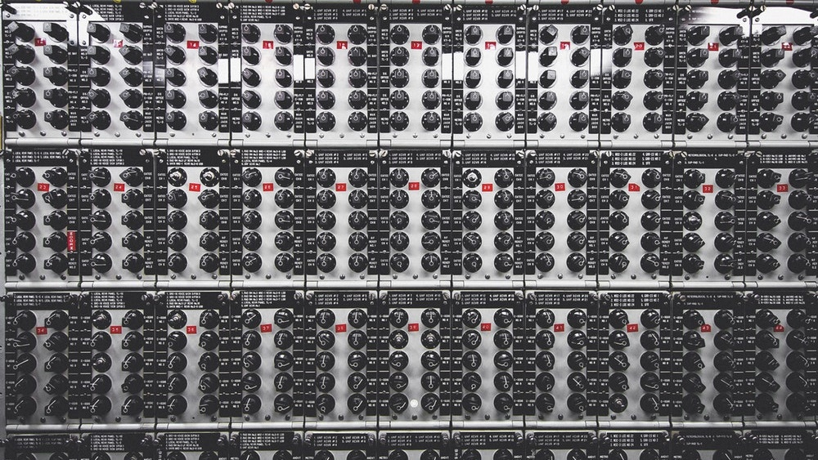
“Business software is hard”
- Everyone who ever built, bought, or used it

Slide 5

Most people don’t work like this.

Slide 6

We work like this.

Slide 7

We work like this.

Slide 8

We work like this.

Slide 9
easy access everywhere
security and governance
task-specific guidance
We all need
apps that work like we do
fast iteration

Slide 10
Only so many problems can be solved with off-the-shelf SaaS
Custom software development is time consuming and costly
Everything else is a missed opportunity to optimize.
Notes:
Developing customer software to if often privileged for a handful of business apps, as building customer applications to meet enterprise requirement has its own challenges :
Time consuming : developing of a customer mobile app can take anywhere from 3 to 12 months for a single project, depending on the app complexity (source ADT magazine). This becomes challenging in situation where LOB wants to respond and implement improvements quickly
Cost prohibitive : driven by a shortage of specialized resourcing : 94% of the enterprise organization have a shortage of App developers, as a lot of App developers still prioritize consumer facing Apps (Source ADT Magazine & Vision Mobile)
Off-the-shelf SaaS can only solve so many problems
Most ‘off-the-shelf’ SaaS solutions are targeted as solving specific problems` and often come with their own mobile App. These apps provide a mobilize experience of these specific SaaS solutions.
However, the onslaught of information from these individual often disconnected SaaS services will virtually make it impossible for workers to follow everyday business processes. More and more business process will span multiple applications and SaaS services. (Source: eWeek)

Slide 11
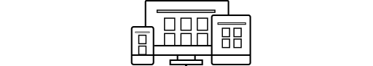



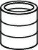

Business Application PaaS (aPaaS) Layer
Build modern business apps—fast Compose analytics, user experiences, and automation using an integrated set of services from Microsoft.
MEASURE
ACT
AUTOMATE
Empower line of business (citizen developers) Help power users who understand their business needs best build solutions quickly without writing code.
Power users
Power BI
PowerApps
Microsoft Flow
Azure Data Analytics
Azure Data Warehouse
SQL Server BI
…
Azure API Management
Azure Functions
Azure AppServices
…
Azure Logic Apps
Azure Event Grid
BizTalk
…
Enable professional developers to extend Leverage Azure platform services to provide capabilities and components for power users.
Developers
Connect to data across apps and platforms Get more value from your data, whether you use the Common Data Service or integrate your app with existing systems and services.
Common Data Service
Connectors & Gateways

Slide 12
Office 365 +
Dynamics 365
Power Suite
Power BI
PowerApps
Flow
Common Data Service
Connectors + Gateways
Azure

Slide 13
MEASURE
ACT
AUTOMATE
Microsoft PowerApps
Power users
Power BI
PowerApps
Microsoft Flow
Developers and IT pros
Pro BI
Pro Dev
Pro Integration
Common data model
Connectors + gateways
Notes:
Karen: PowerApps, Flow+ SharePoint demo(11-25)

Slide 14

What is PowerApps?
PowerApps
It makes Apps from other things

Slide 15
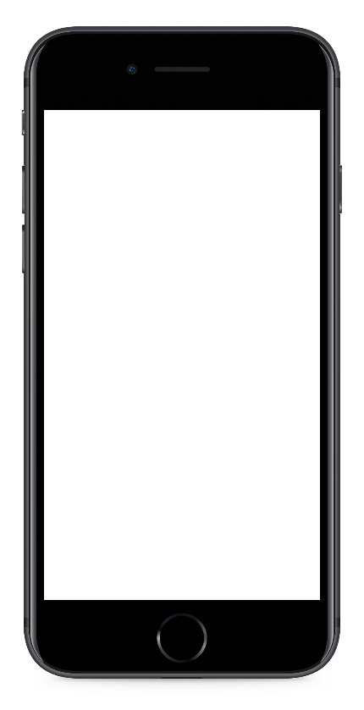
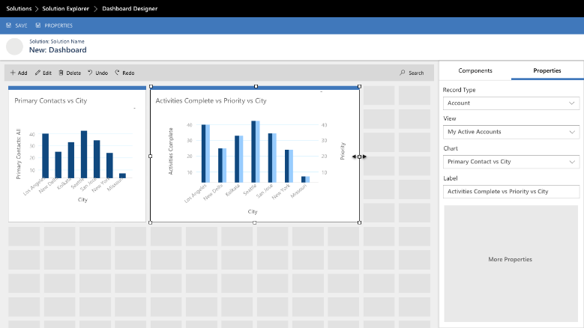
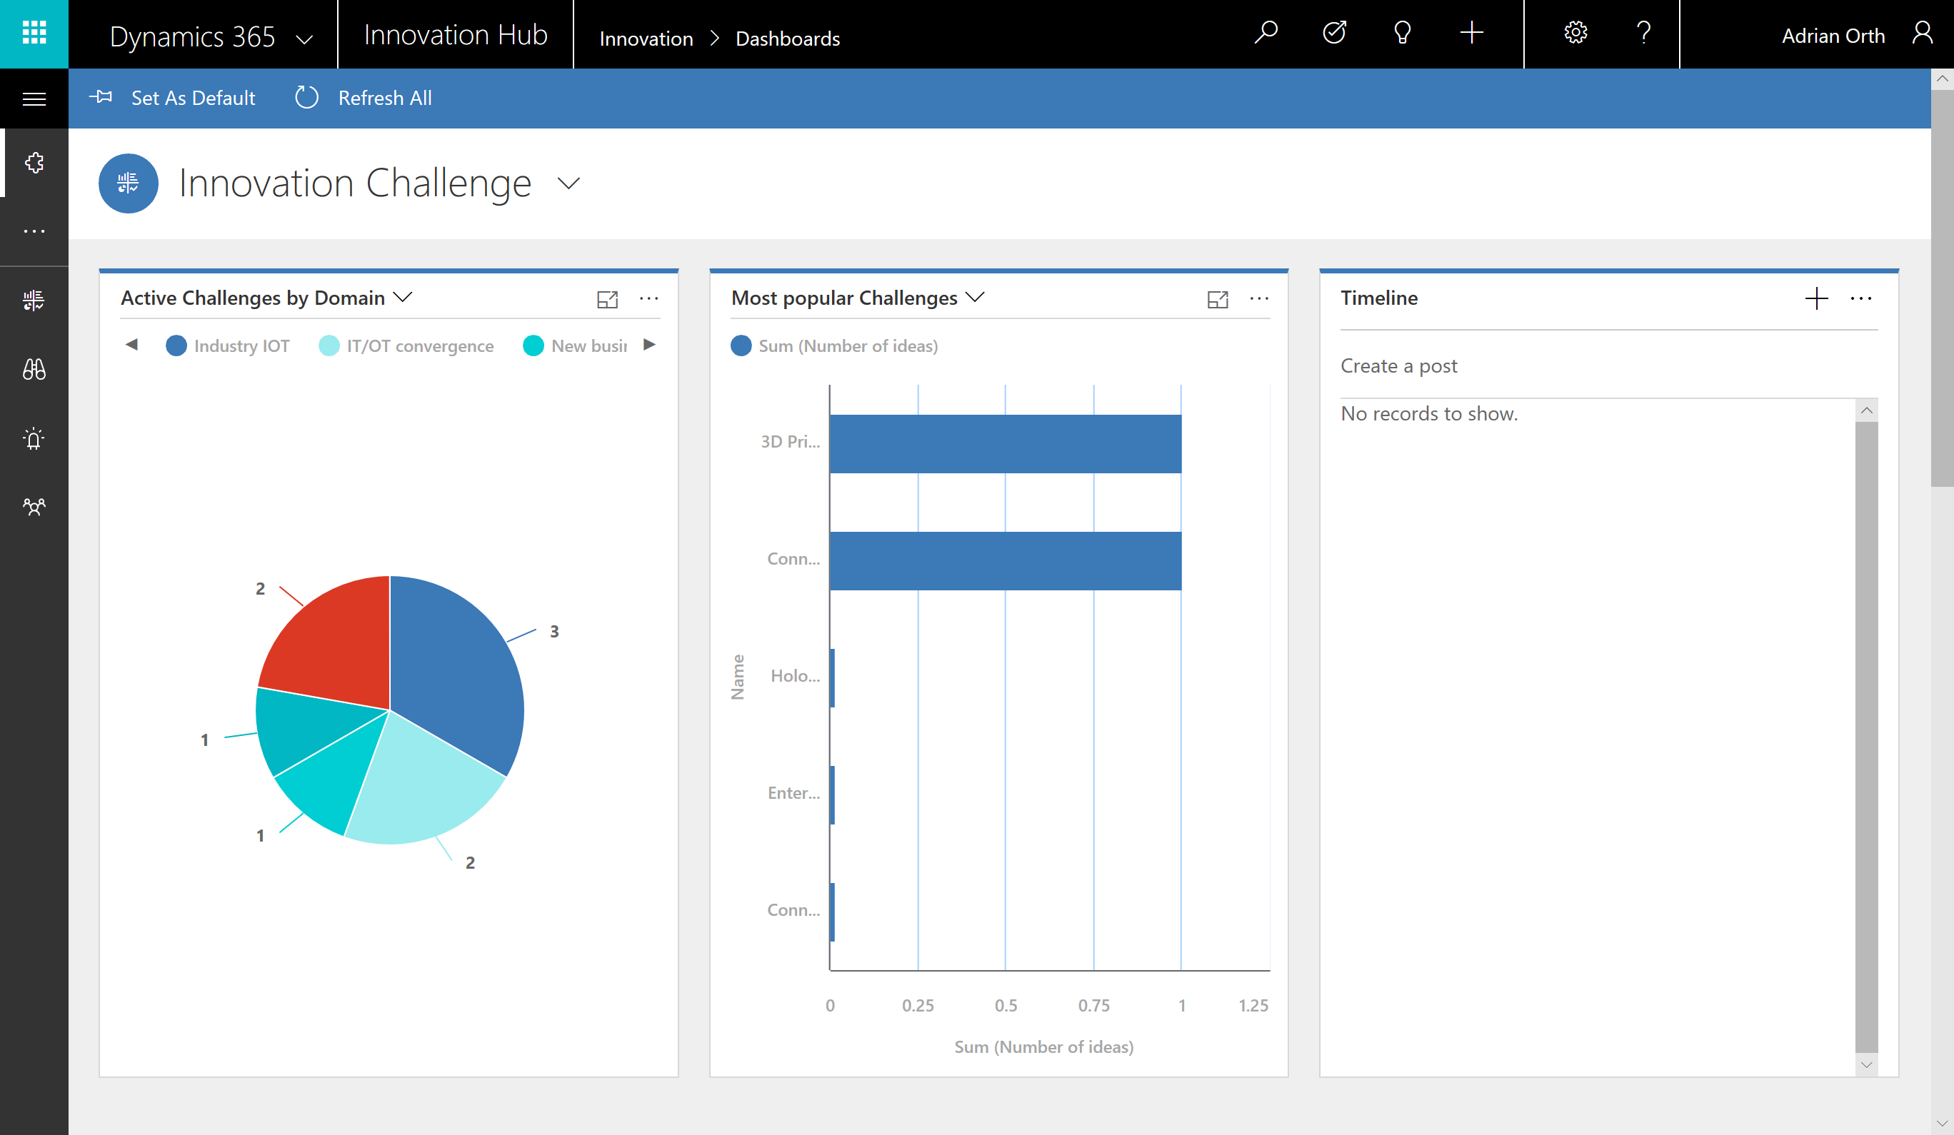
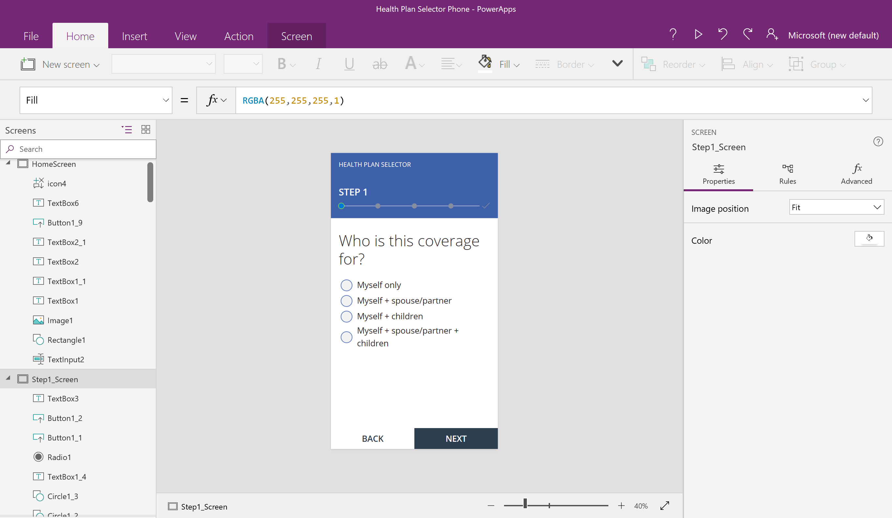
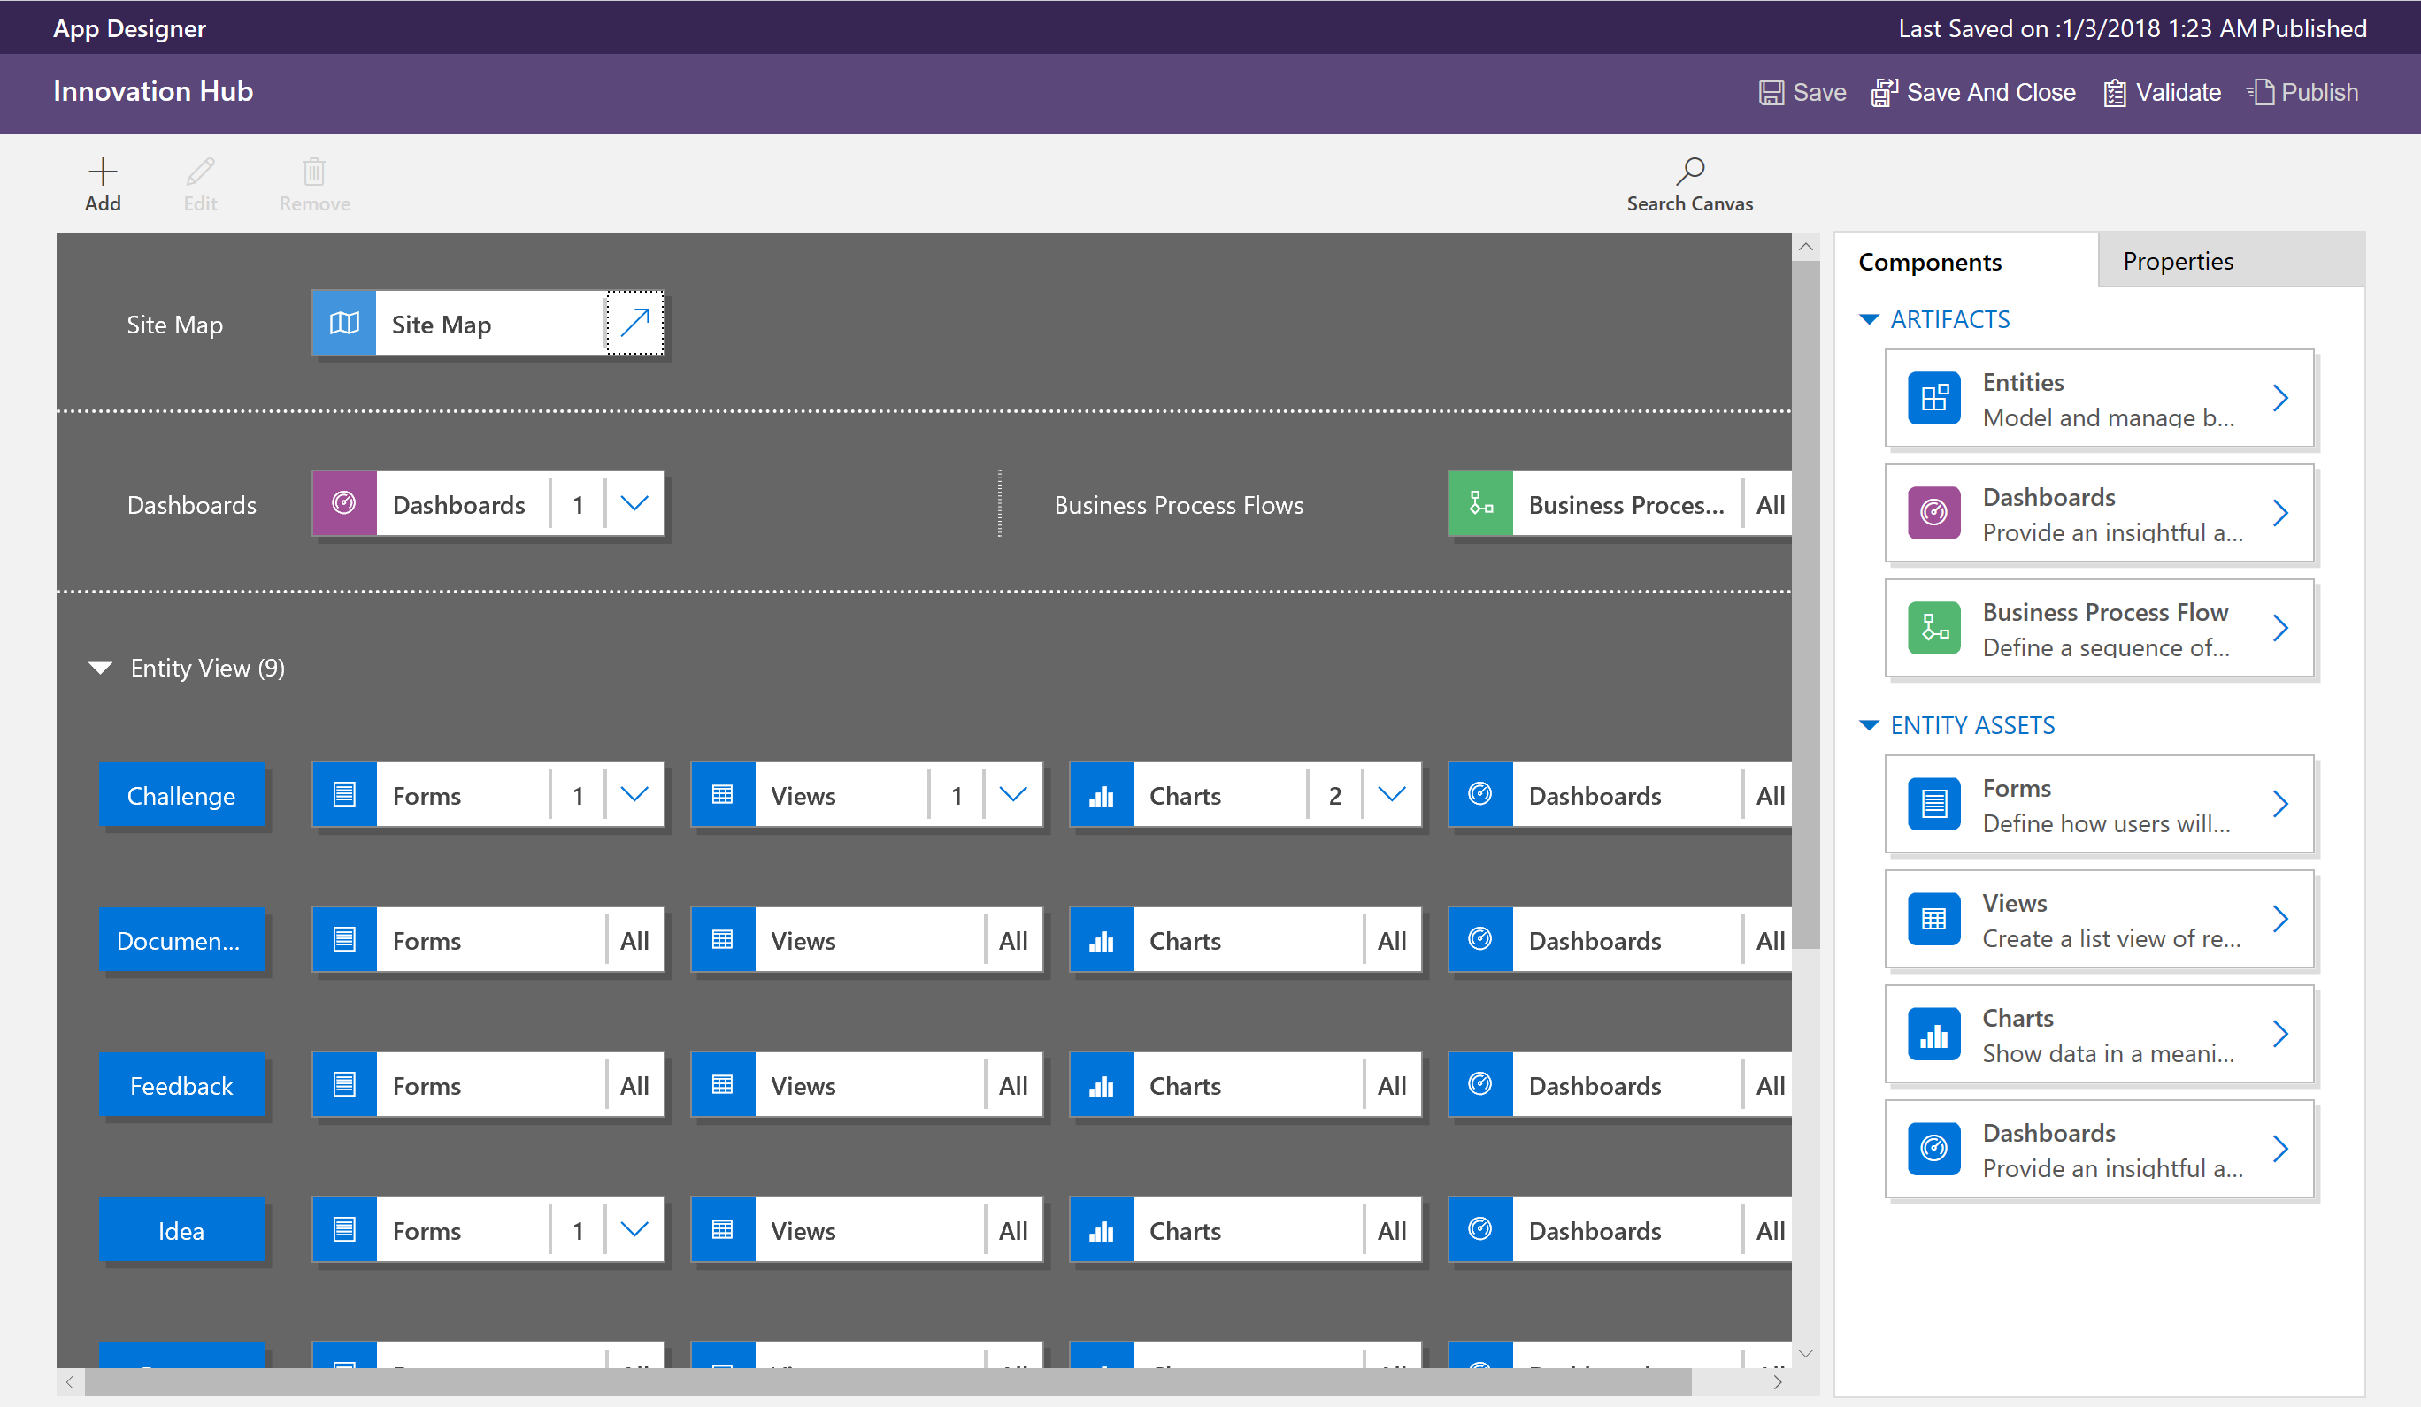

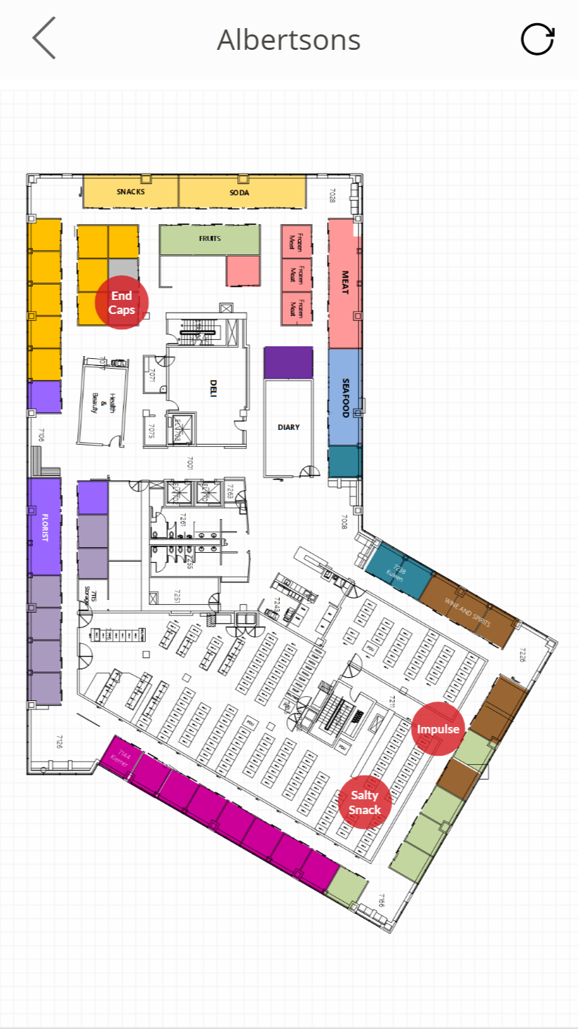
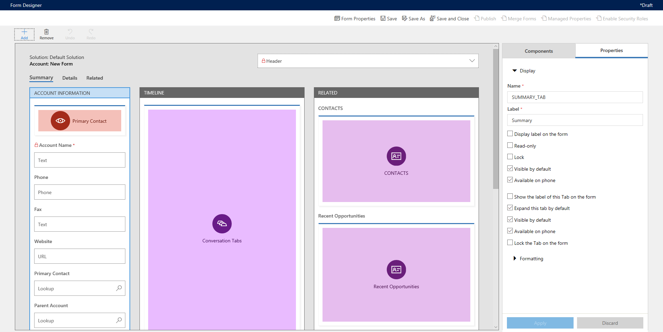
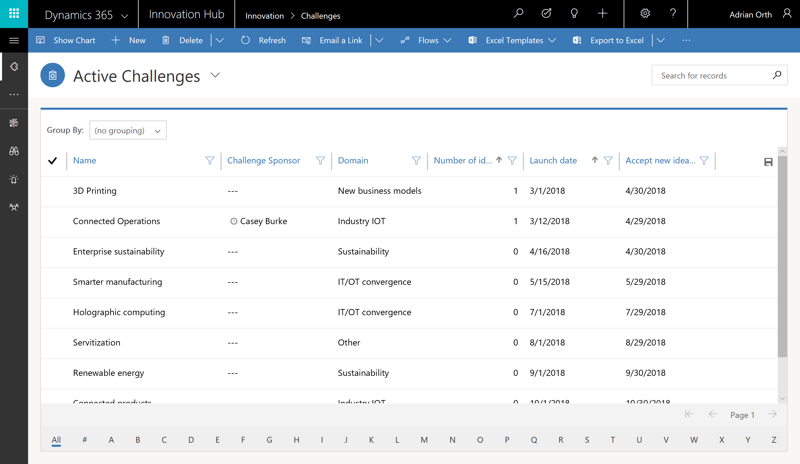
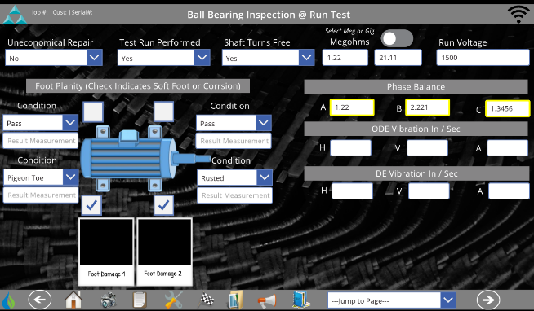
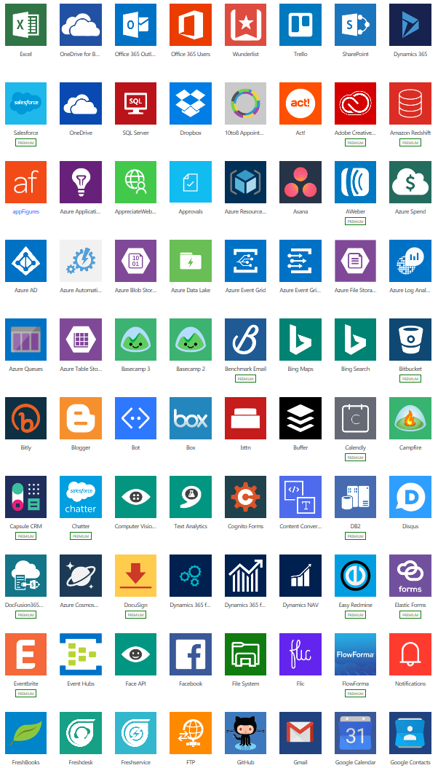
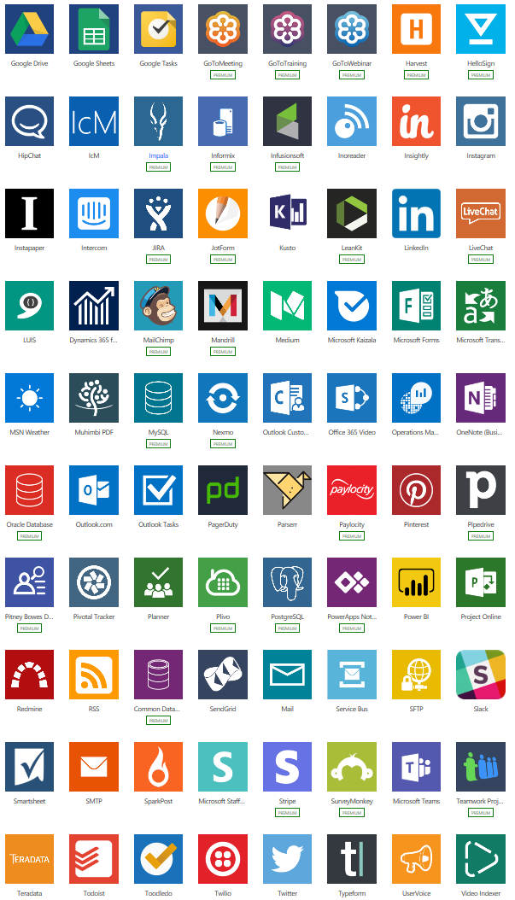
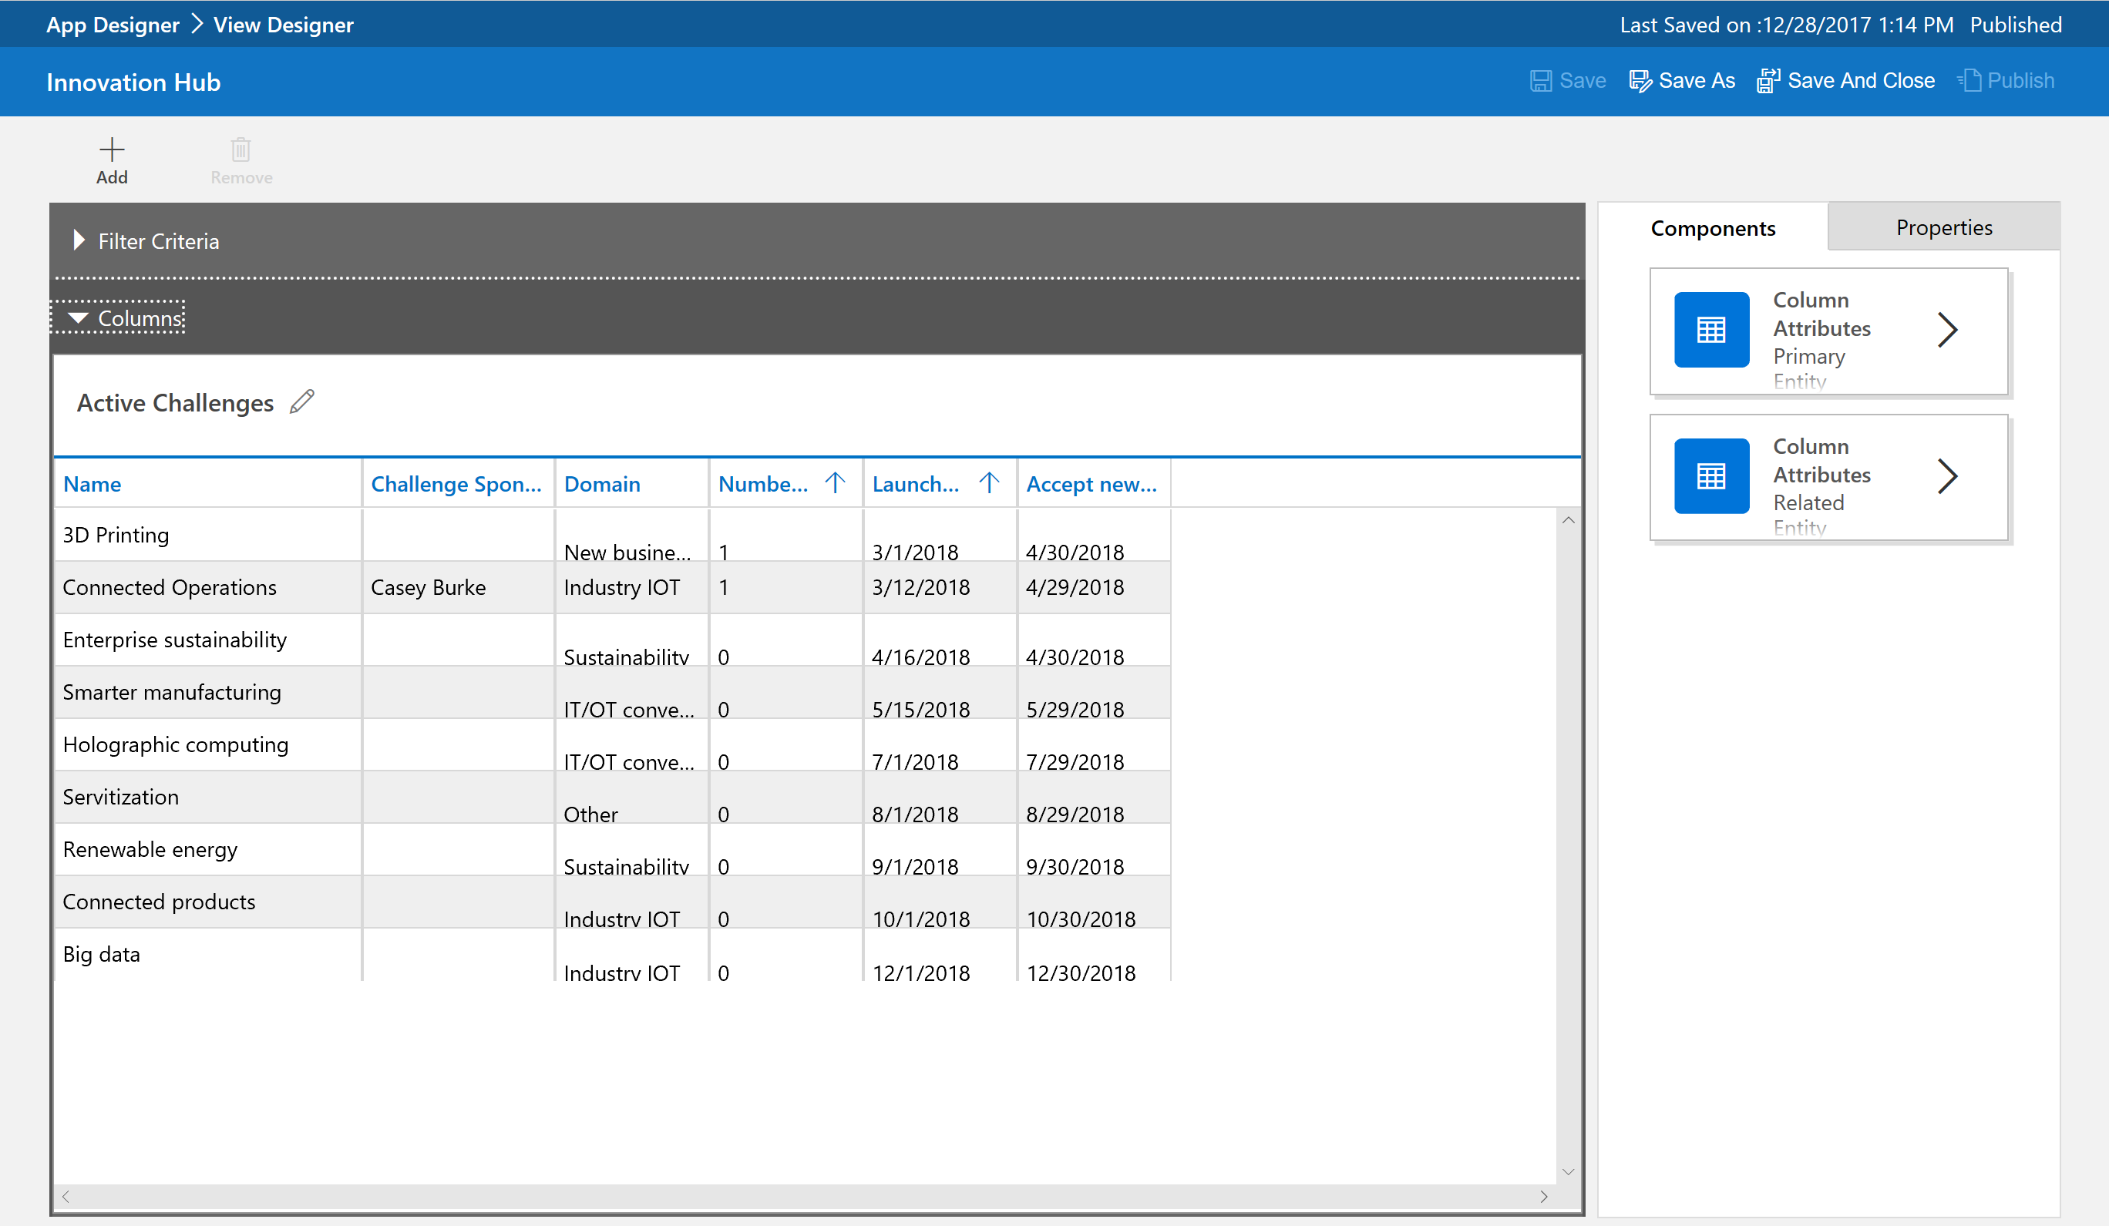
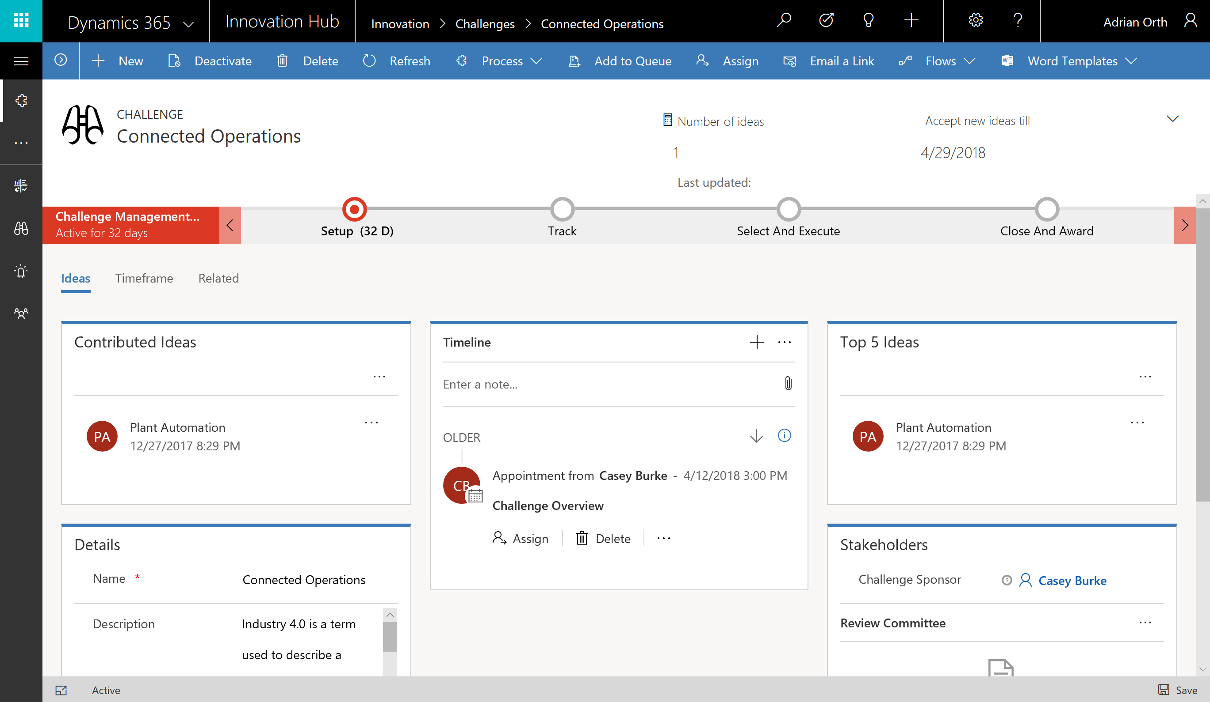
Canvas apps start with user experience, with pixel-perfect control to build highly customized task- and role-based apps that mash up data from 190+ sources
Model-driven apps leverage your data model, relationships, and business processes to automatically generate immersive, responsive applications

Slide 16

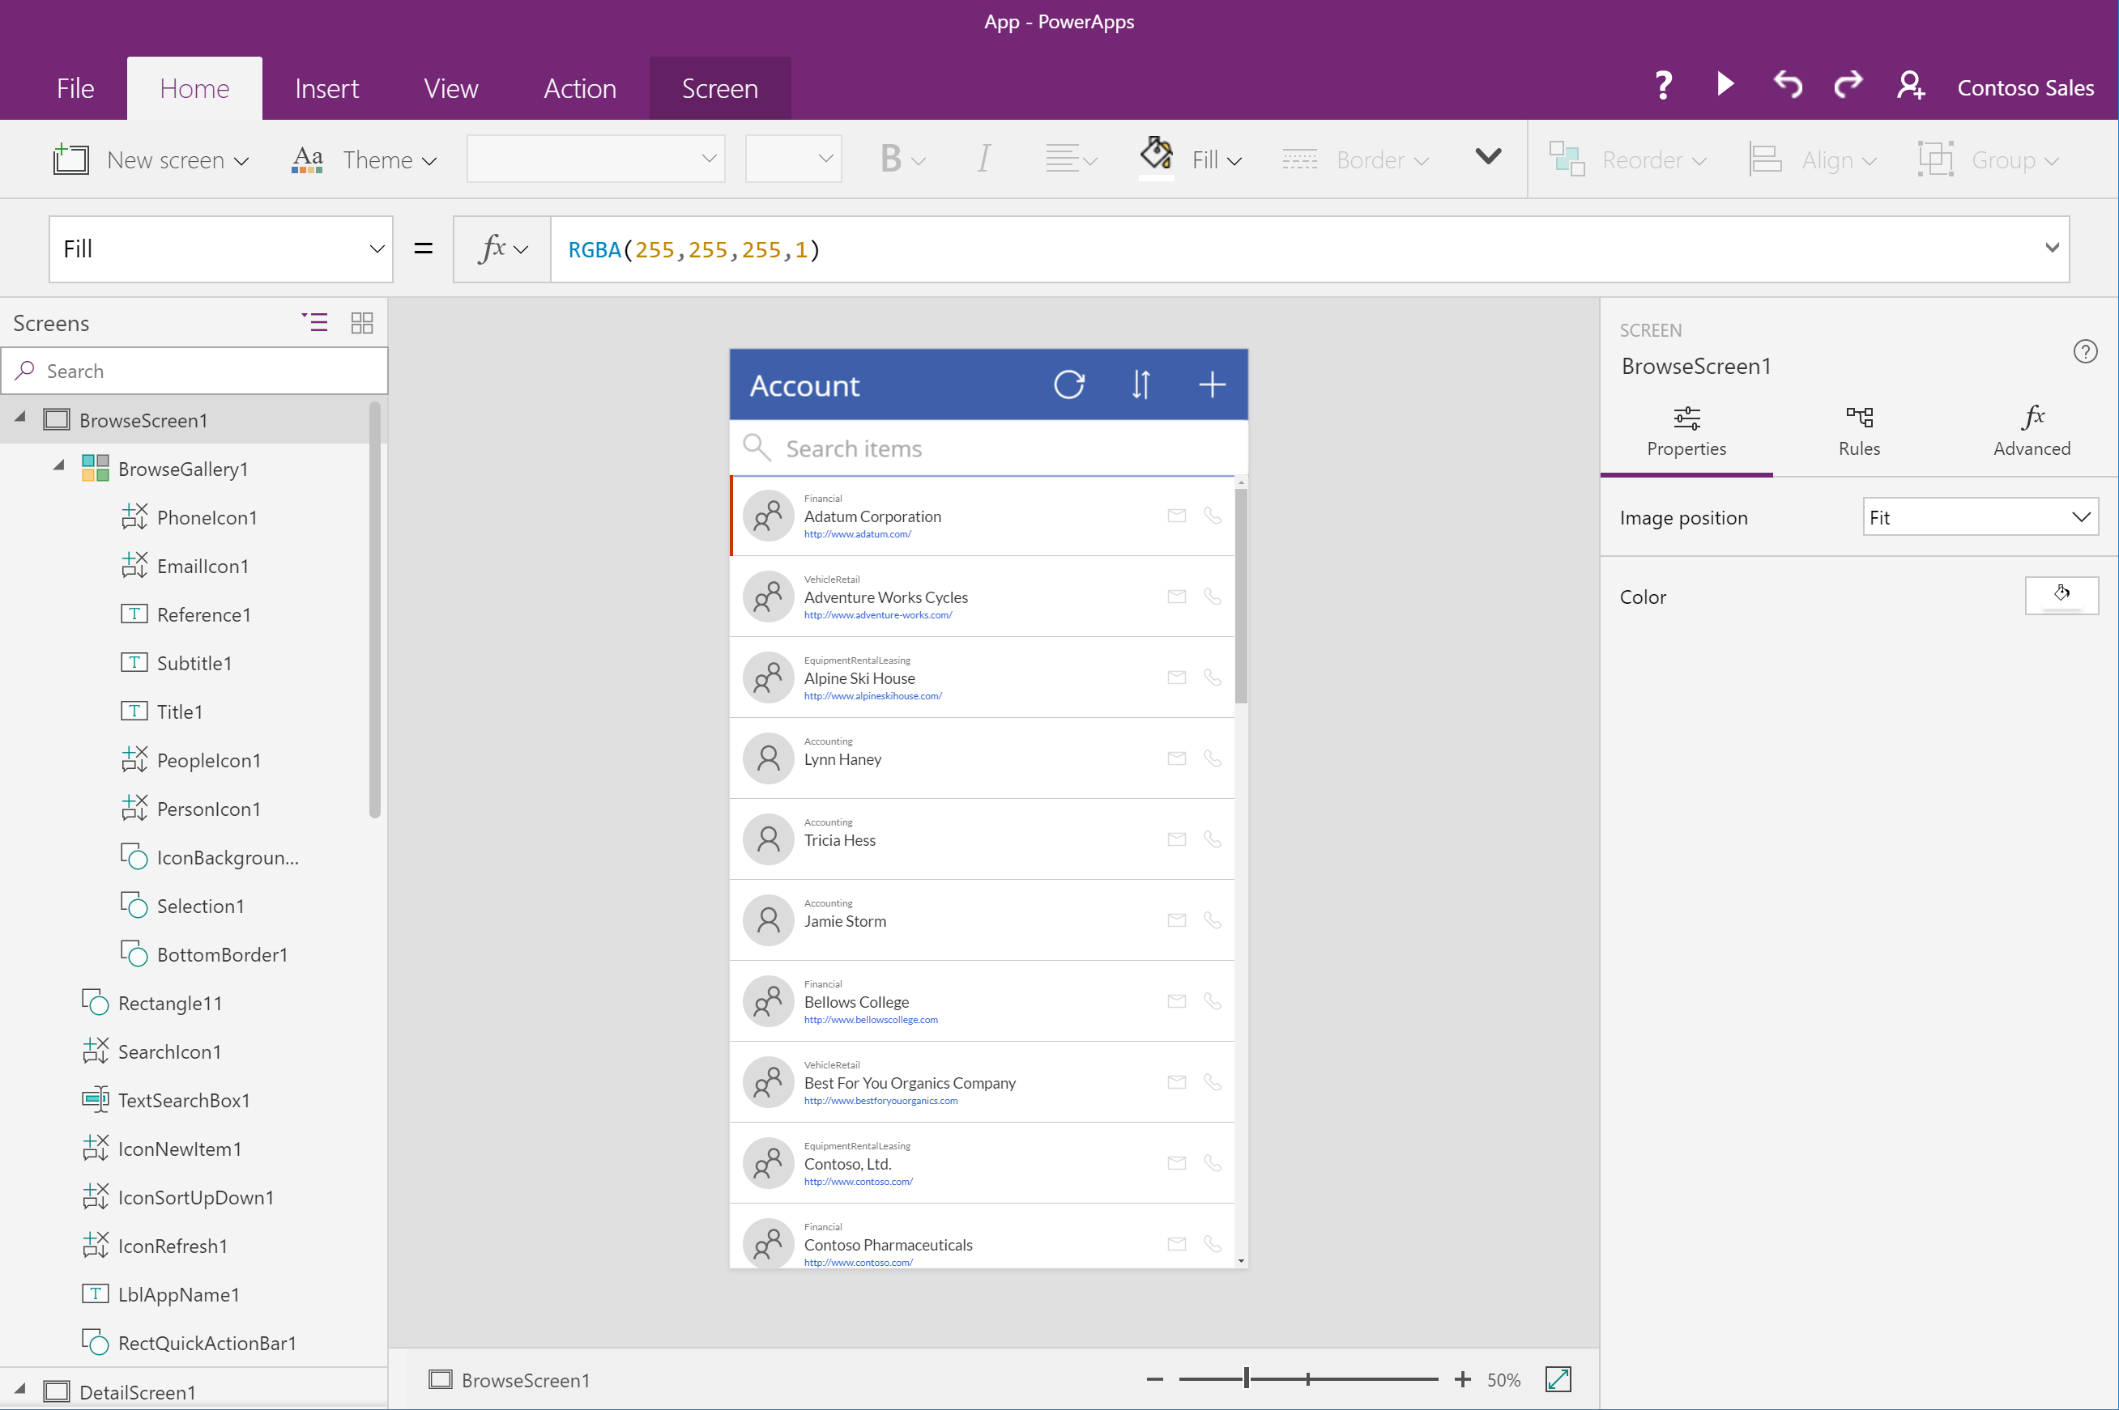
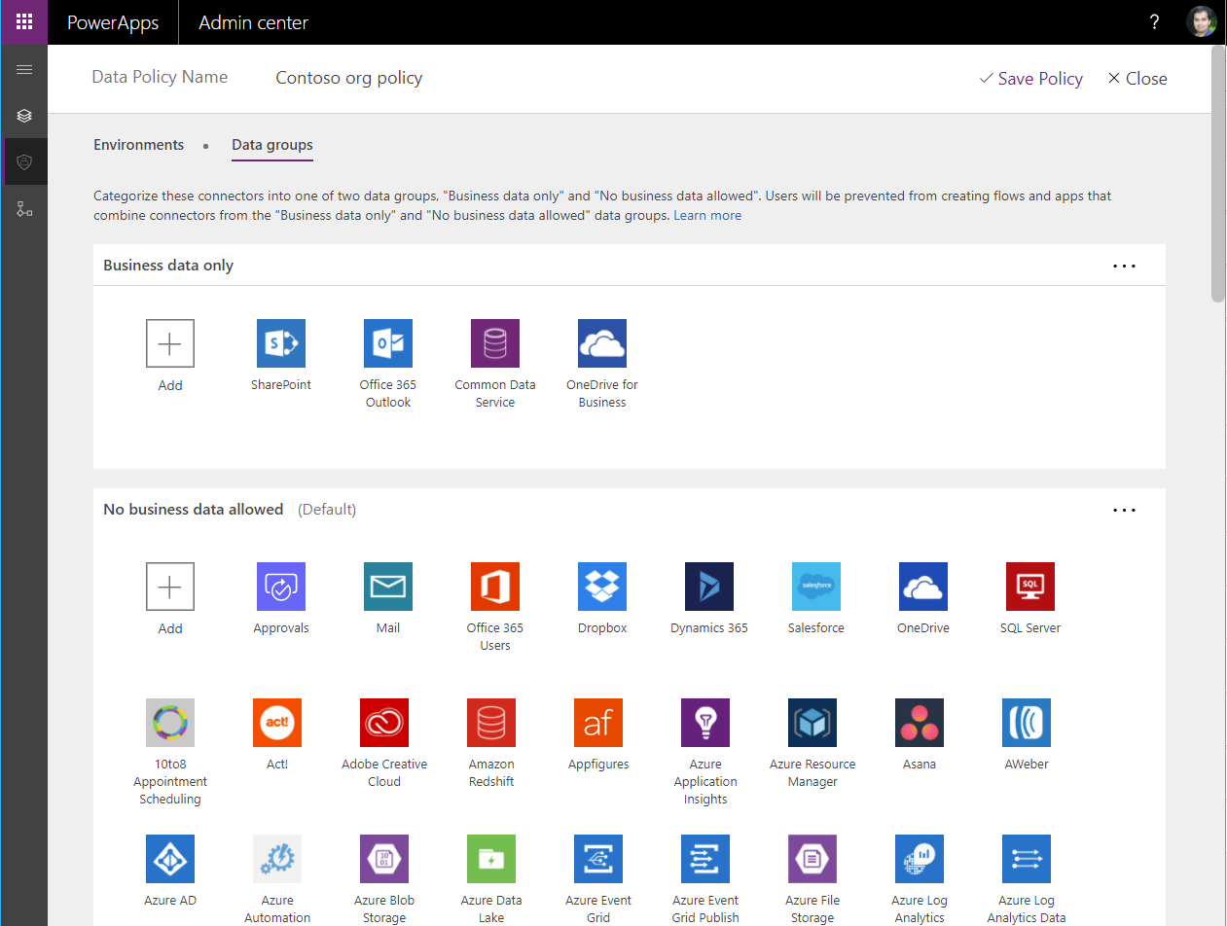
Easy Authoring
Truly WYSIWYG – full control over user experience, use it as you build it
Create app logic with familiar Excel-like expressions
Mash up data from multiple sources right at the app level
Notes:
IN the past tools for power users often ended up becoming a nightmare for IT. IT meant users were creating business critical apps or databases, but ran them on a computer under their desk, and a kicked out ethernet cable could have a huge impact.
PowerApps and Flow have been built with an understanding of the needs of IT from the ground up. So we make sure that Powerusers can easily be productive and solve problems and optimize what they do, but also make sure that Tenant admins have full visibility on what apps and flows are running in the company, how much they are used etc.
We have DLP policies to enforce restrictions about data flow for example, to restrict which data sources or connectors can be used with that SQL server (yes we of course can connect to SQL as well!)
We also have brought the concepts of enviroments to the platform, to make sure a team can easily adminsitrer data, flows and apps for their world (and yes, tenant admisn of course can see and manage all of those ebvironmments!)
And of course, as you expect from Microsoft we have all the expected compliance certifications you expect, suchas HIPAA, SOC, Model clause etc.

Slide 17
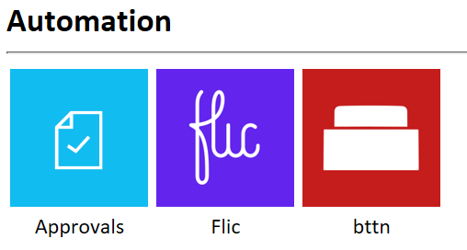
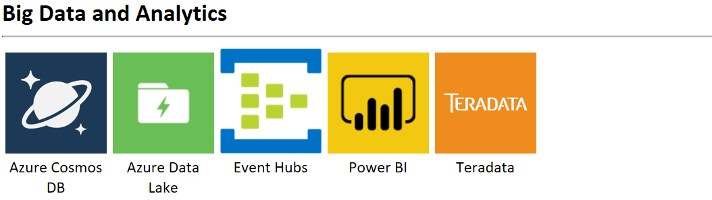
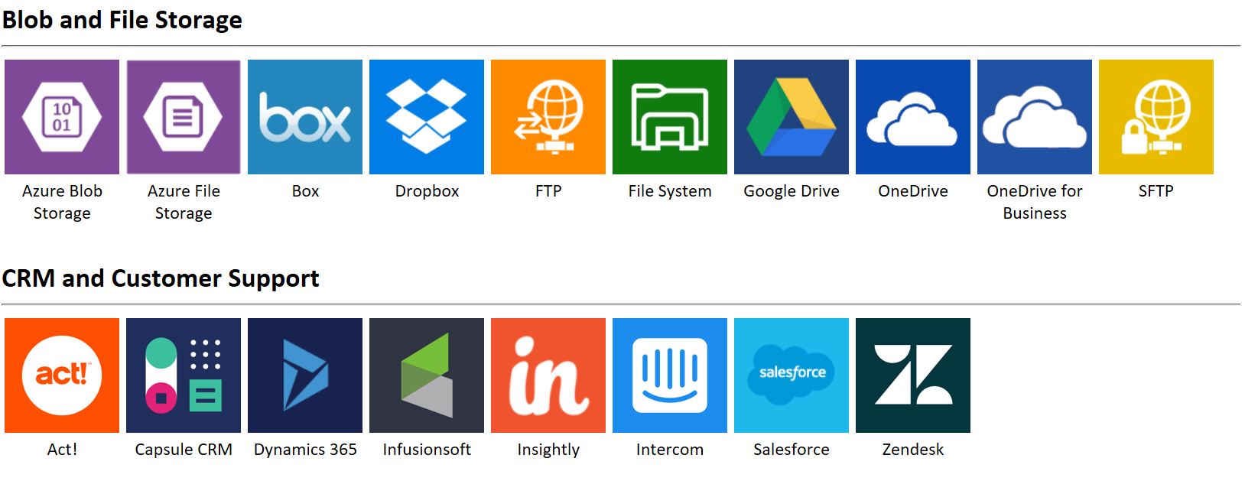
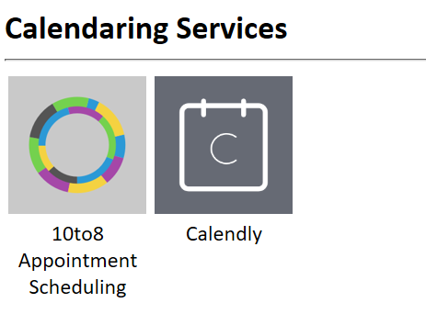
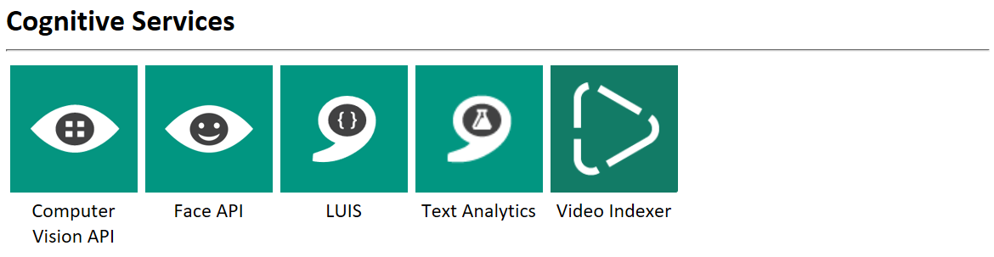
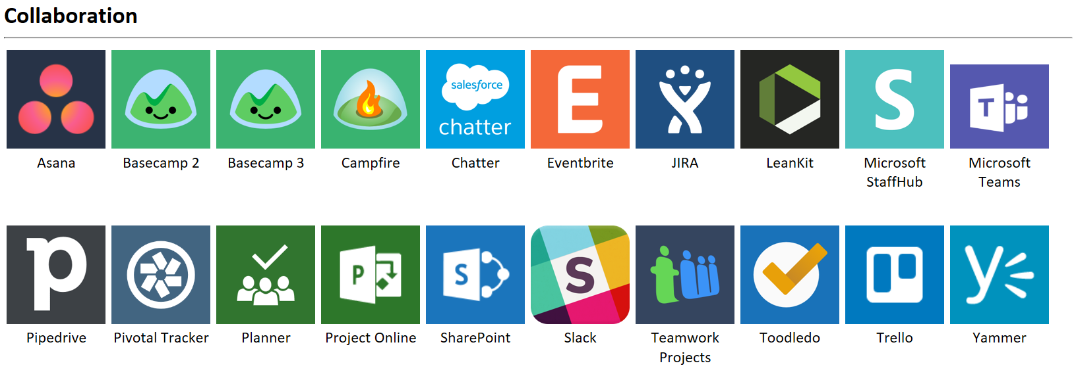
Connected data
Common data service provides a rich platform + standard model that gets creators instantly productive
Add 200+ connected data sources
Add custom connectors and on-premises sources
Notes:
IN the past tools for power users often ended up becoming a nightmare for IT. IT meant users were creating business critical apps or databases, but ran them on a computer under their desk, and a kicked out ethernet cable could have a huge impact.
PowerApps and Flow have been built with an understanding of the needs of IT from the ground up. So we make sure that Powerusers can easily be productive and solve problems and optimize what they do, but also make sure that Tenant admins have full visibility on what apps and flows are running in the company, how much they are used etc.
We have DLP policies to enforce restrictions about data flow for example, to restrict which data sources or connectors can be used with that SQL server (yes we of course can connect to SQL as well!)
We also have brought the concepts of enviroments to the platform, to make sure a team can easily adminsitrer data, flows and apps for their world (and yes, tenant admisn of course can see and manage all of those ebvironmments!)
And of course, as you expect from Microsoft we have all the expected compliance certifications you expect, suchas HIPAA, SOC, Model clause etc.

Slide 18
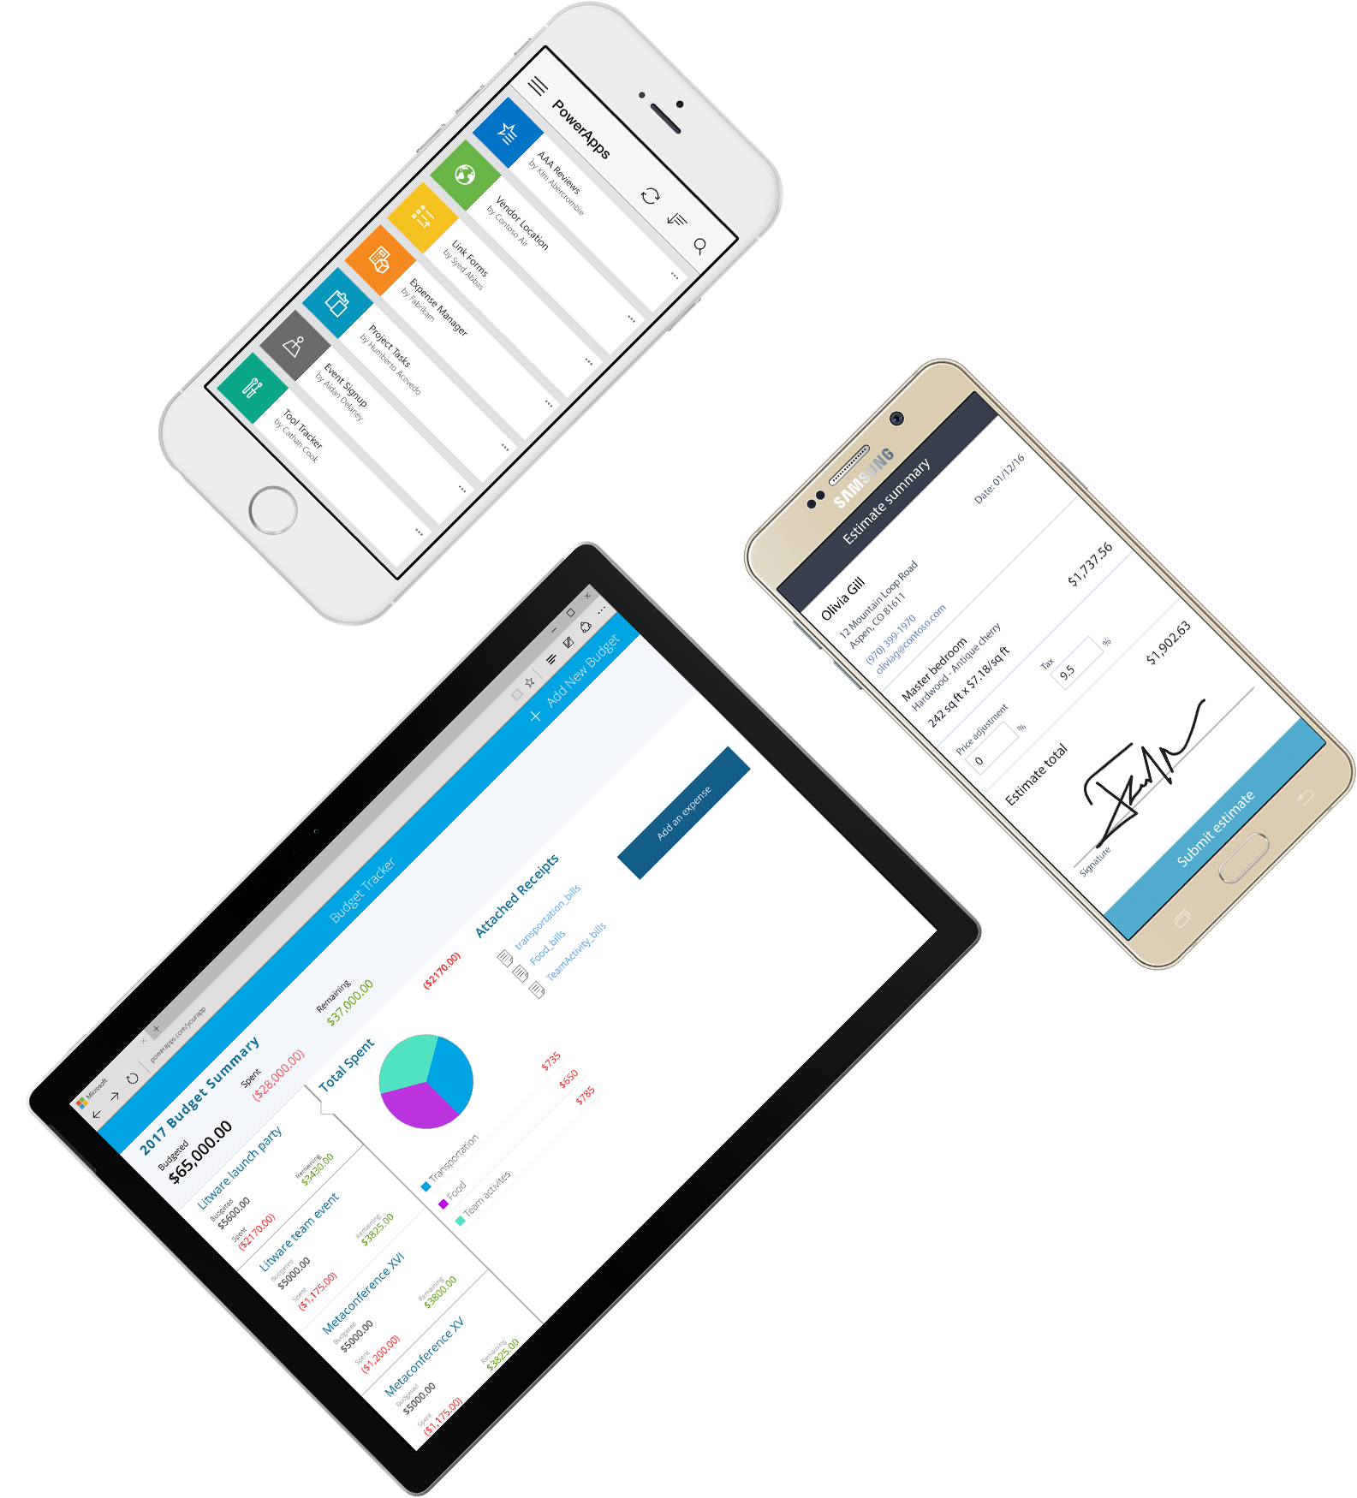
Cross-platform
Publish instantly to iOS, Android, Windows, and the web
Sharing apps is like sharing documents
Manage across environments
Notes:
IN the past tools for power users often ended up becoming a nightmare for IT. IT meant users were creating business critical apps or databases, but ran them on a computer under their desk, and a kicked out ethernet cable could have a huge impact.
PowerApps and Flow have been built with an understanding of the needs of IT from the ground up. So we make sure that Powerusers can easily be productive and solve problems and optimize what they do, but also make sure that Tenant admins have full visibility on what apps and flows are running in the company, how much they are used etc.
We have DLP policies to enforce restrictions about data flow for example, to restrict which data sources or connectors can be used with that SQL server (yes we of course can connect to SQL as well!)
We also have brought the concepts of enviroments to the platform, to make sure a team can easily adminsitrer data, flows and apps for their world (and yes, tenant admisn of course can see and manage all of those ebvironmments!)
And of course, as you expect from Microsoft we have all the expected compliance certifications you expect, suchas HIPAA, SOC, Model clause etc.

Slide 19
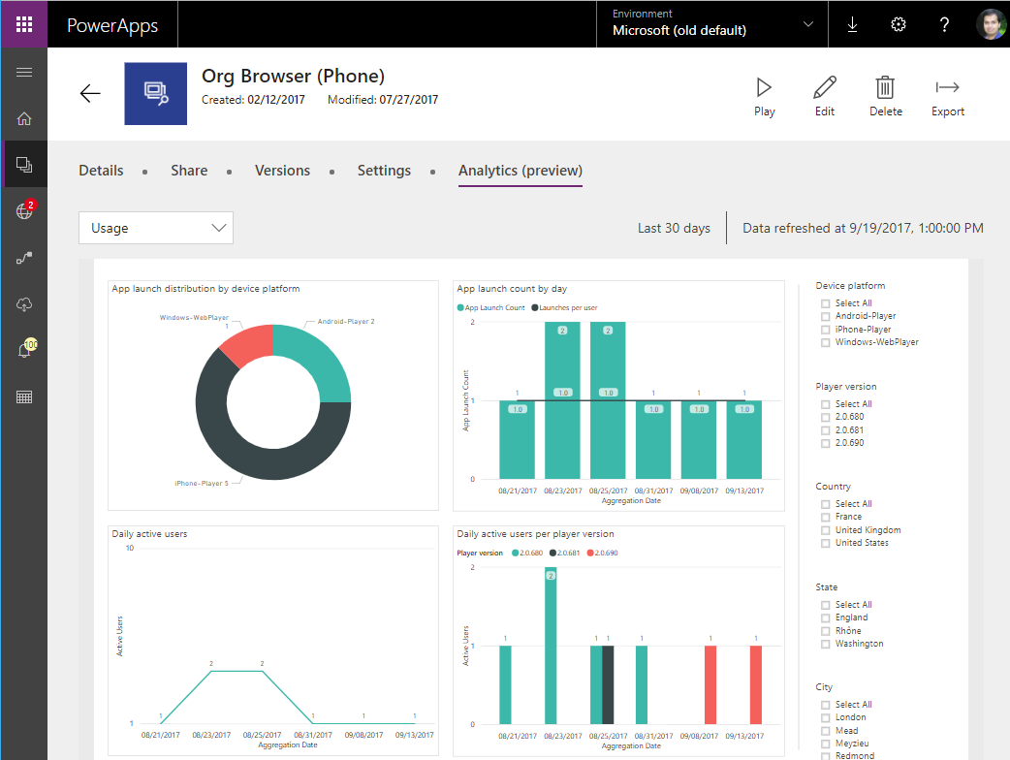
Enterprise Ready
Centrally view app telemetry and manage apps
Set DLP policy on data and connectors
Compliance with 13+ standards inc. HIPAA, EU Model Clauses & SOC
Notes:
IN the past tools for power users often ended up becoming a nightmare for IT. IT meant users were creating business critical apps or databases, but ran them on a computer under their desk, and a kicked out ethernet cable could have a huge impact.
PowerApps and Flow have been built with an understanding of the needs of IT from the ground up. So we make sure that Powerusers can easily be productive and solve problems and optimize what they do, but also make sure that Tenant admins have full visibility on what apps and flows are running in the company, how much they are used etc.
We have DLP policies to enforce restrictions about data flow for example, to restrict which data sources or connectors can be used with that SQL server (yes we of course can connect to SQL as well!)
We also have brought the concepts of enviroments to the platform, to make sure a team can easily adminsitrer data, flows and apps for their world (and yes, tenant admisn of course can see and manage all of those ebvironmments!)
And of course, as you expect from Microsoft we have all the expected compliance certifications you expect, suchas HIPAA, SOC, Model clause etc.

Slide 20
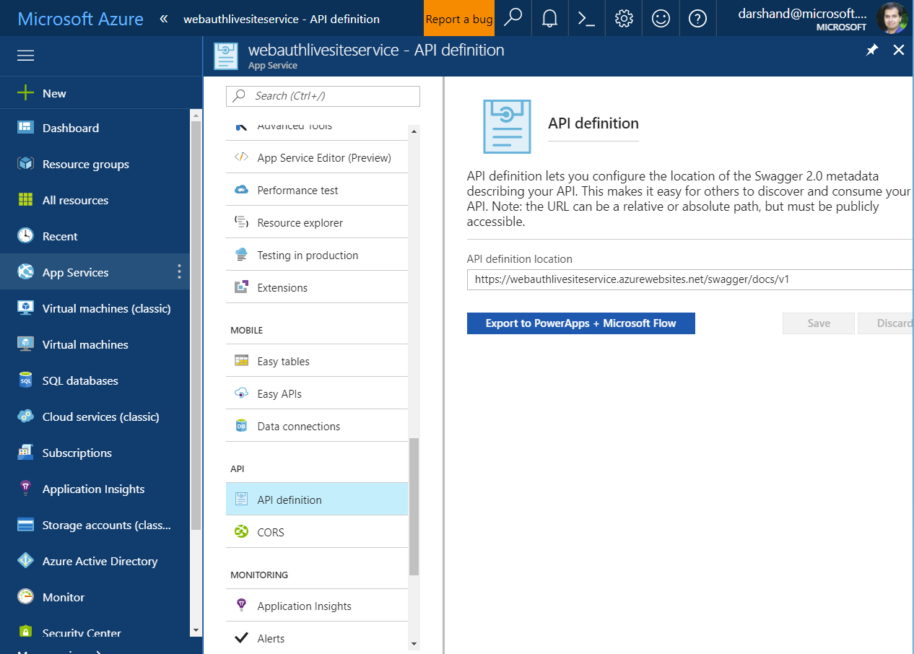
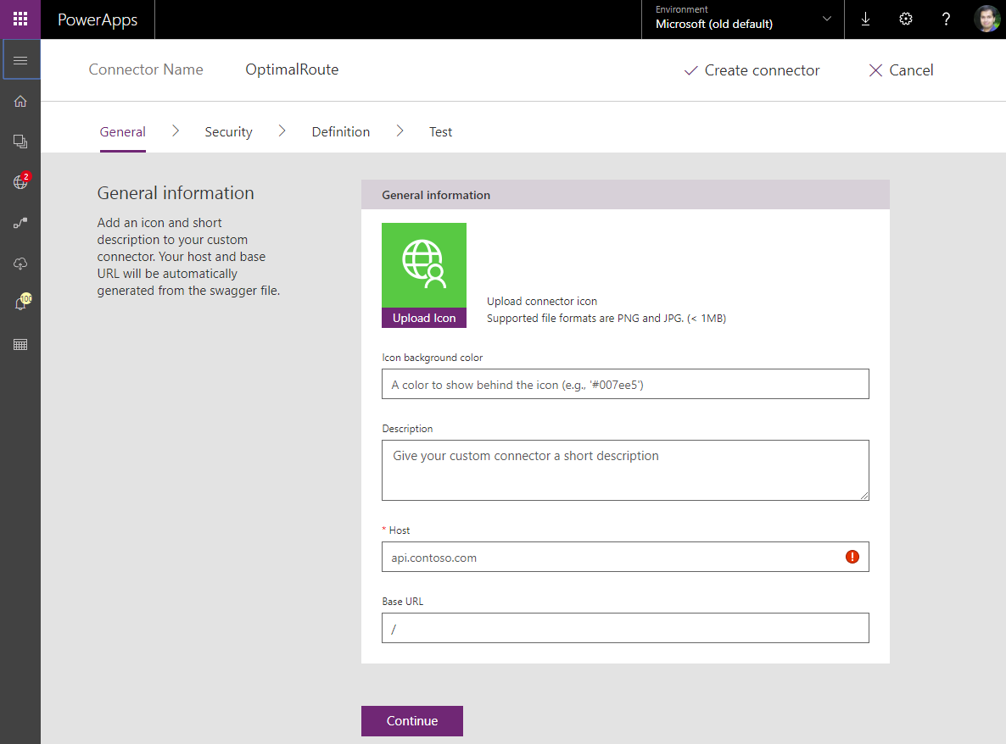
Pro developers welcome…
Build apps that go beyond what you get in the box
Build reusable custom app components & connectors
Leverage the full power of Azure capabilities
Notes:
So pro devs can easily provide components to implement things that are best done in code!
One great example is the ability to provide what we call “Custom connectors”. Even though we already have 160+ connectors out the box, I am sure you have some custom systems. Don’t you wish you could use them from PowerApps or Flow just like the ones we provide connectors for? Well, if it has a Rest API you can! A Swagger file is all that it takes to create a custom connector that is exposed and lets you access your custom system right there from the Fow editor or from PowerApps. And coming soon, custom connectors will even extend to on-premises as we are adding custom conector support to our gateway (where we already support things lke your SQL server on premise).
If you need custom code, mabe for some complex scheduling or route optimization, just have pro devs build it, maybe as an Azure function and it can then seemlessy be called from your powerAPp and beprovided as a building block to Citizen developers! The Serverless computing Azure functions are providing really is an awesome fit for PowerApps, no need to worry about VM capacity, just run it as a function and we’ll scale in thebackground to provide the capacity needed as it gets called, you only pay for the capacity you are using. Higjly recommend attending the Funcrtions sessions if you aren’t familiar with what we are building there.

Slide 21
Canvas apps and Model-driven apps are complementary to each other
Canvas Apps | Model Driven Apps
Start with the User Experience or Data | Start with the Data Model (schema)
Build visually appealing, pixel-perfect apps | Component-driven approach to app building
Use concepts like screens, controls, formulae, connections | Use components like site maps, entities, forms, views, charts, dashboards, business process flows
Separate mobile and tablet app creation experiences | Responsive web & mobile apps out of the box
Create mash-up apps using data from multiple data sources using the 200+ connectors or custom connectors | Create apps using entities and virtual-entities in CDS for Apps
Use any PowerApps license (Office 365/P1-P2 or Dynamics 365) | Only PowerApps Plan 2 or Dynamics 365 Enterprise license
Great for building task-focused apps for a specific personas | Great for back-office scenarios involving complex business processes
Security and access for the data is managed on the data-source chosen | Add role-based security and row-level security to your data
Use entities stored in CDS for Apps through CDS connector (P1/P2 required) | Use Business Process Flows, code add-ins & real-time workflows

Slide 22
DEMO
SharePoint – Time Off Request App
Notes:
Karen

Slide 23
MEASURE
ACT
AUTOMATE
Microsoft Flow
Power users
Power BI
PowerApps
Microsoft Flow
Developers and IT pros
Pro BI
Pro Dev
Pro Integration
Common data model
Connectors + gateways

Slide 24

What is Flow?
Microsoft Flow
It does things when something happens

Slide 25

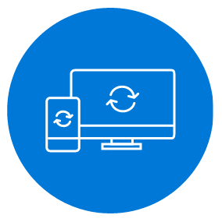
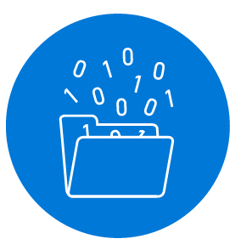

Microsoft Flow helps you work smarter by automating workflow across your apps and services
Get notifications
Synchronize data
Collect data
Automate approvals
Notes:
SaaS to allow power users/business analysts to automate common or more complex tasks.

Slide 26
Microsoft Flow Mobile & Devices
Work less and do more, from anywhere
Create new flows
Grant approvals
Get push notifications
Monitor flow activity
Discover buttons
Use button widgets
Create, run, and manage automated workflows between your favorite apps and services – even when you're on the go!

Slide 27
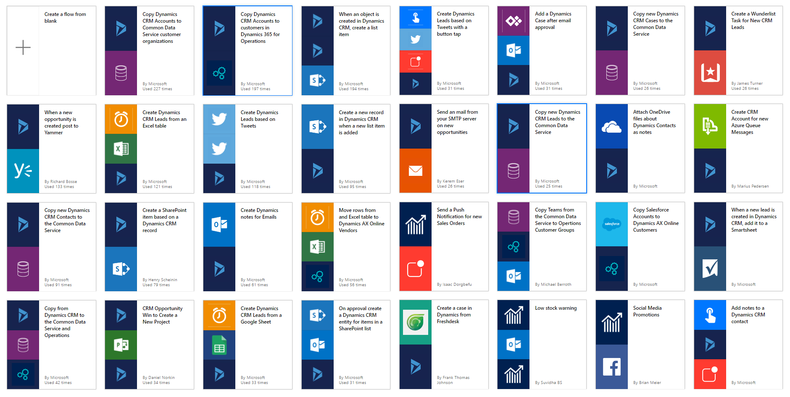
Templates help users to get started
Notes:
User aver 100+ templates (and growing) for common scenarios as a starting point to create your new workflow!
Various use cases – many of which have been submitted by users like yourselves.

Slide 28



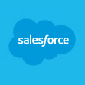

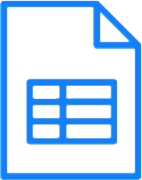

Automate advanced scenarios with multiple steps, branching conditions, and more
Get notifications
Synchronize files
Collect data
Automate approvals

Slide 29
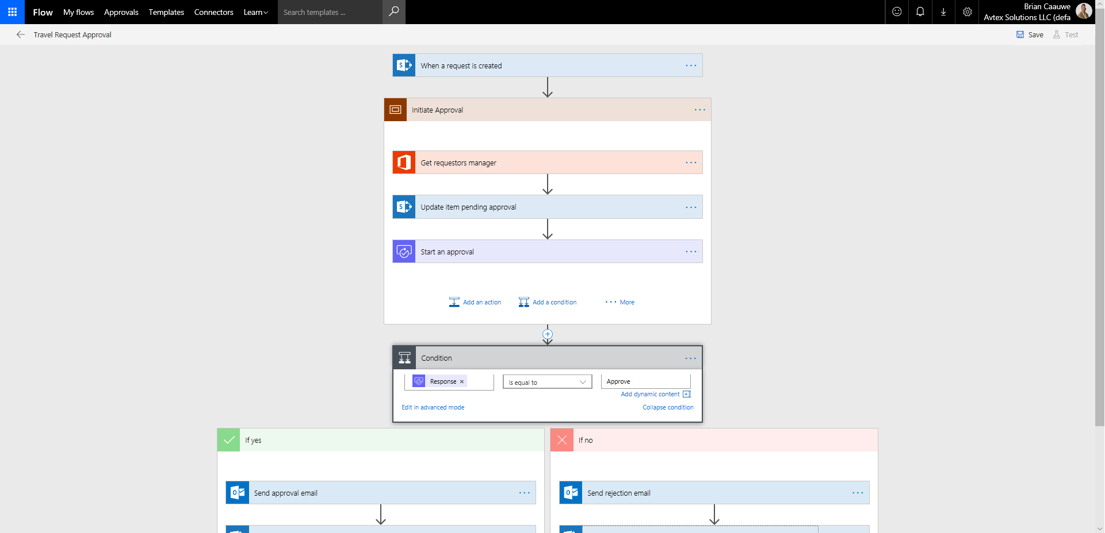
Flow Designer
Flow Name
Trigger
Scope
Actions
Condition

Slide 30
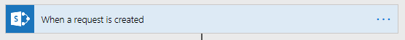
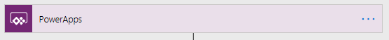
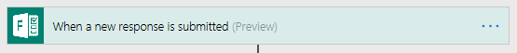
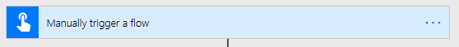
Flow Core Concepts
Trigger – the event that kicks off the flow:
200+ Services
Shared connectors with
Power BI
PowerApps
Notes:
In addition to utilizing Templates, end-users can easily build their own Flows or customize any of the available templates through an easy to use visual designer.
In this example I want to receive and email in my Exchange email box every time a new file gets added to my Dropbox account.
Simply select the “Dropbox - When a file is created” trigger and provide my account details to authenticate. Once authenticated and can simplify select the folder I want to monitor on my account.
As a next step, I select the Office 365 Outlook – Send email function. This will prompted my to logon to my O365 email account. I have different properties available which I use directly in the subject, body an ‘To’ address of the message that will be send based on the Drop box trigger.
I simply save the Flow I just created, and it is now ready for execution.

Slide 31
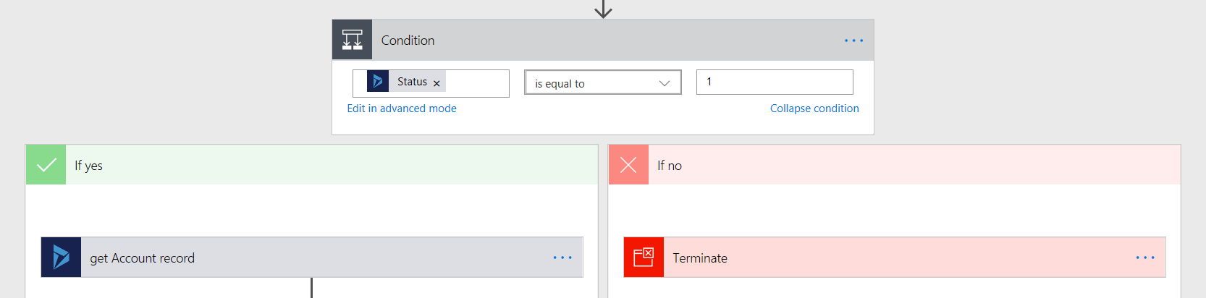
Flow Core Concepts
Condition – determines the branch:
Yes
No

Slide 32
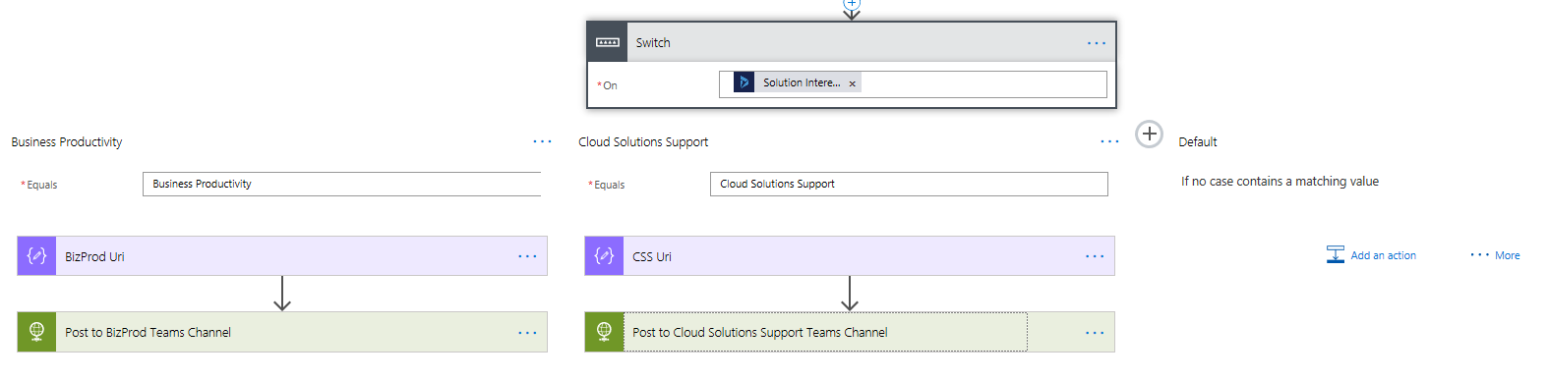
Flow Core Concepts
Switch – different actions based on a single value

Slide 33
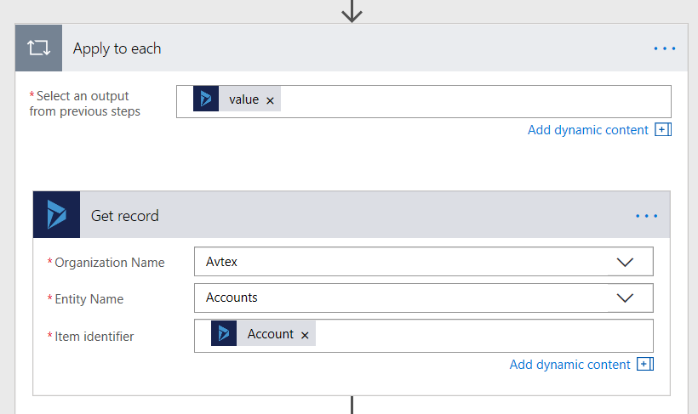
Flow Core Concepts
Apply to Each – loops through a collection of items

Slide 34
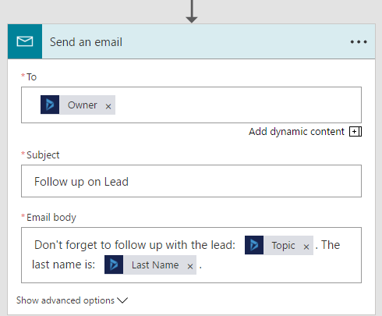
Flow Core Concepts
Actions – what the flow does
Can use data from the trigger

Slide 35
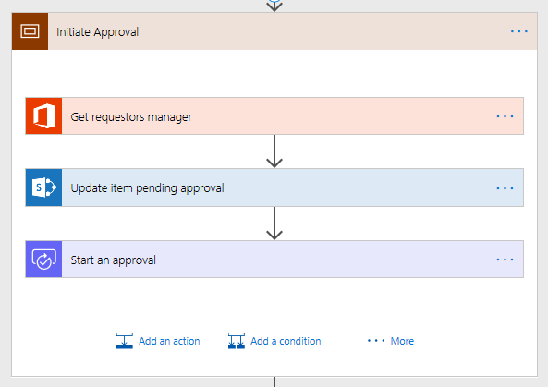
Flow Core Concepts
Scopes – group actions together

Slide 36
DEMO
Flow
Time Off Request App
Notes:
Karen

Slide 37
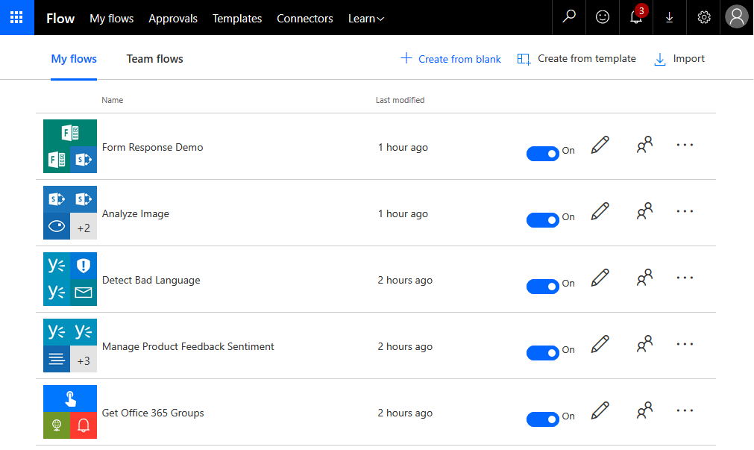
Flow Types
My Flows
Originated by you
You are the only one that can manage

Slide 38
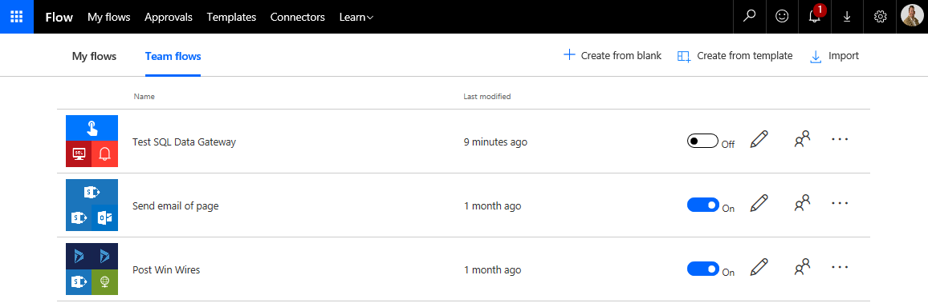
Flow Types
Team Flows
Originated by anyone
Multiple people can manage
You have been granted owner rights

Slide 39
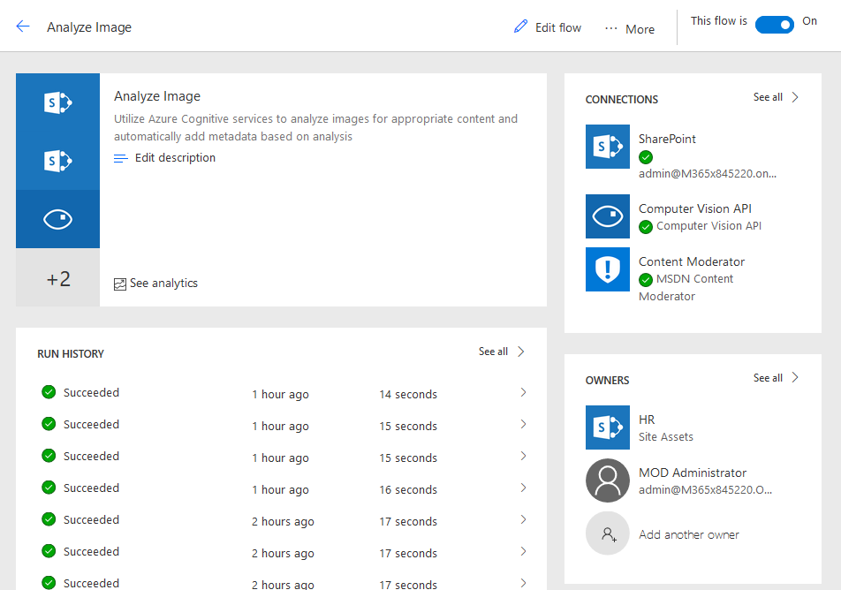
Ownership
Owners can be
Individuals
Office 365 Groups
SharePoint Lists or Libraries*
Owners can
Edit / Update / Delete Flow
Assign other owners
Use ALL connections
Connections embed credentials for who created the connection

Slide 40
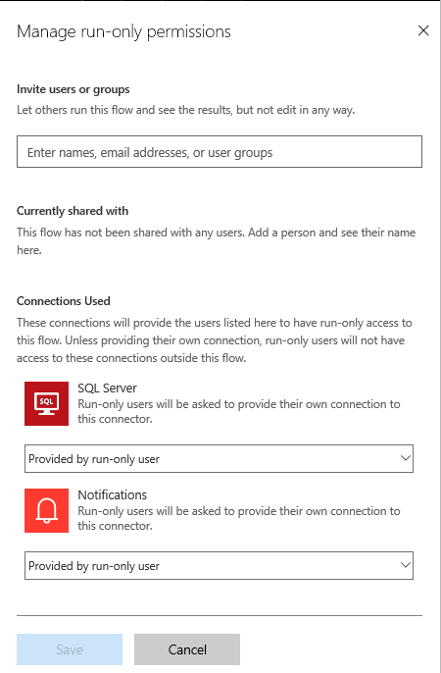
Run-Only
Manual initiation
Users can be
Individuals
Office 365 Groups
SharePoint Lists or Libraries*
Users can
Run the flow
See results
Use connections
Connections embed credentials for who created the connection
Provided by run-only user

Slide 41
Lab 1 - Hands-on steps
Build PowerApp
Visit SharePoint Time Off Request List (http://aka.ms/timeoffreq)
Create PowerApp
Update data on all 3 screens
Build Flow
Visit SharePoint Time Off Request List
Create Flow
Verify approval email data
Run it
Notes:
Karen: Transition to Bart

Slide 42
Administration Tools
Environments
DLP
Dev/Ops
Monitoring
Notes:
Bart – Demo this flow from MTC Zero
Bart – Transition to Todd

Slide 43
MEASURE
ACT
AUTOMATE
Common Data Service
Power users
Power BI
PowerApps
Microsoft Flow
Developers and IT pros
Pro BI
Pro Dev
Pro Integration
Common Data Service
Connectors + gateways

Slide 44
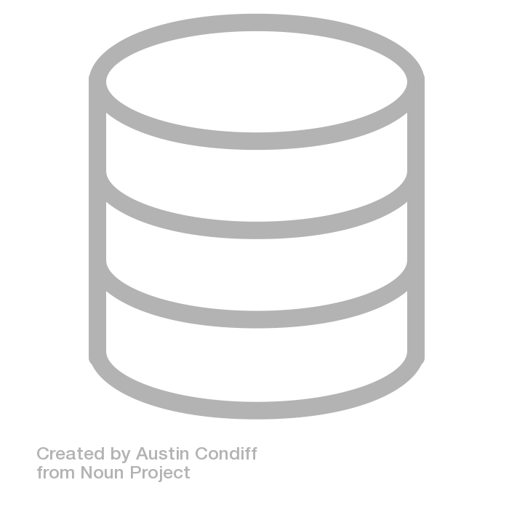
Common Data Service for Apps
a service for connecting data sources and powering apps

Slide 45





The Common Data Service for Apps
A great place to build and manage apps
The Focal Point for your data
CDS for Apps does the heavy lifting to bring together all your data
We have the tools to let all users build apps and intelligence on their data

Slide 46
Theme 1: Focal point for data
CDS for Apps brings a customer’s data together.
Build your app here, benefit from everyone else’s data.
Point-to-point integrations without CDS for Apps
Single point of integration with CDS for Apps
Flow
Flow
Power BI
PowerApps
Your app here
PowerApps
Other Apps/Services
Power BI
Your app
Other Apps
Dynamics 365
Azure AD
Dynamics 365
Azure AD
Office 365
Office 365

Slide 47


Theme 2: Build and Manage Apps
It’s easy to build apps on data in the CDS for Apps.
Manage data security in one, central place.
Build low-code apps with PowerApps on CDS for Apps
Build complex/pro-dev apps on CDS for Apps with the robust SDK
CDS for Apps provides a security substrate to manage apps and protect data

Slide 48





Realizing the Vision, Bringing it together
We are adding the Dynamics 365 Customer Engagement platform (aka xRM) capabilities to PowerApps and the Common Data Service.
Delivering on the Vision and Evolving the business application platform for the future.
Sales
Customer Service
Marketing
Field Service
Project Service Automation
Talent
Your App!
PowerApps Platform
App Creation ( Model and Canvas )
Flow
Gateways and Connectors
Data and Metadata API’s (oData and SOAP)
Common Data Service
Security
Platform Extensibility Engine
(Plugin, Workflow, Rules, *)
Application Runtimes
Entity Storage Platform

Slide 49
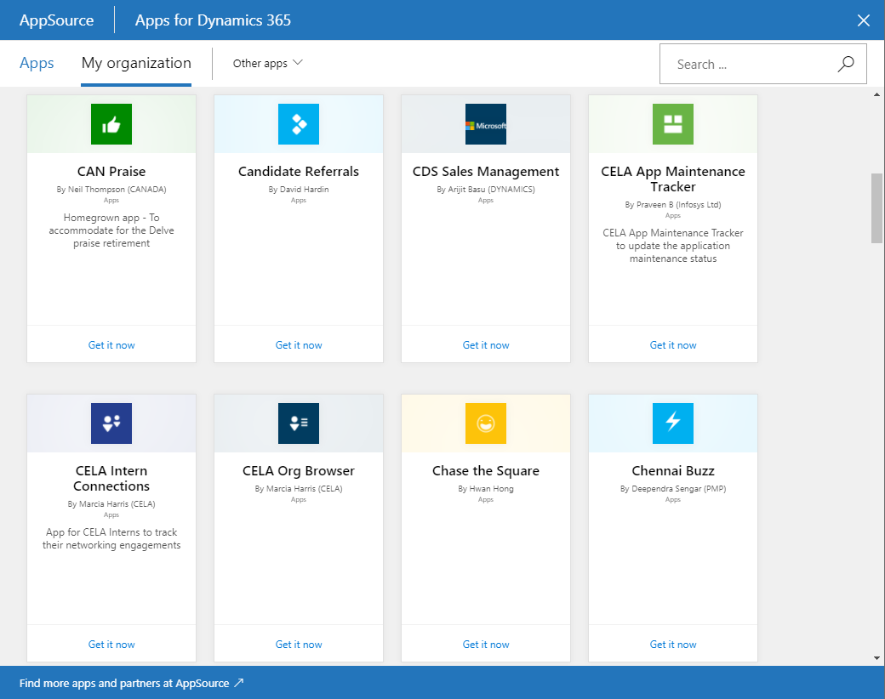
Common Data Model
The Common Data Model (CDM) which provides well-defined, modular, and extensible business entities. Anyone can build on and extend CDM definitions to capture additional business-specific ideas.
Common Data Model - Definitions
Core
Account
CRM
Sales
Team
Product
Invoice
…
…
InvoiceAging
AppSource
SuggestedProducts
Talent
Job
Finance & Operations, etc.
…
Open Sourced at https://github.com/microsoft/cdm
Common Data Service
Apps
Account
Orders
Custom Entity
Apps
Invoice
InvoiceAging
…
Product
SuggestedProducts
Notes:
2:10

Slide 50
Planned CDM Modules
Application Common
Default module and installed on CDS out of the box.
Contains many common entities that support the most common operations in CDS.
Additional Modules will be added over time.
Human Capital Management
Supports HR and HCM schema’s
Service Common
Will support customer service centric schema’s
Retail
Will support retail operation centric schema’s
Marketing Common
Will support marketing application centric schema’s
Sales Common
Will support sales force automation application centric schema’s
Project Common
Will support project management application centric schema’s

Slide 51
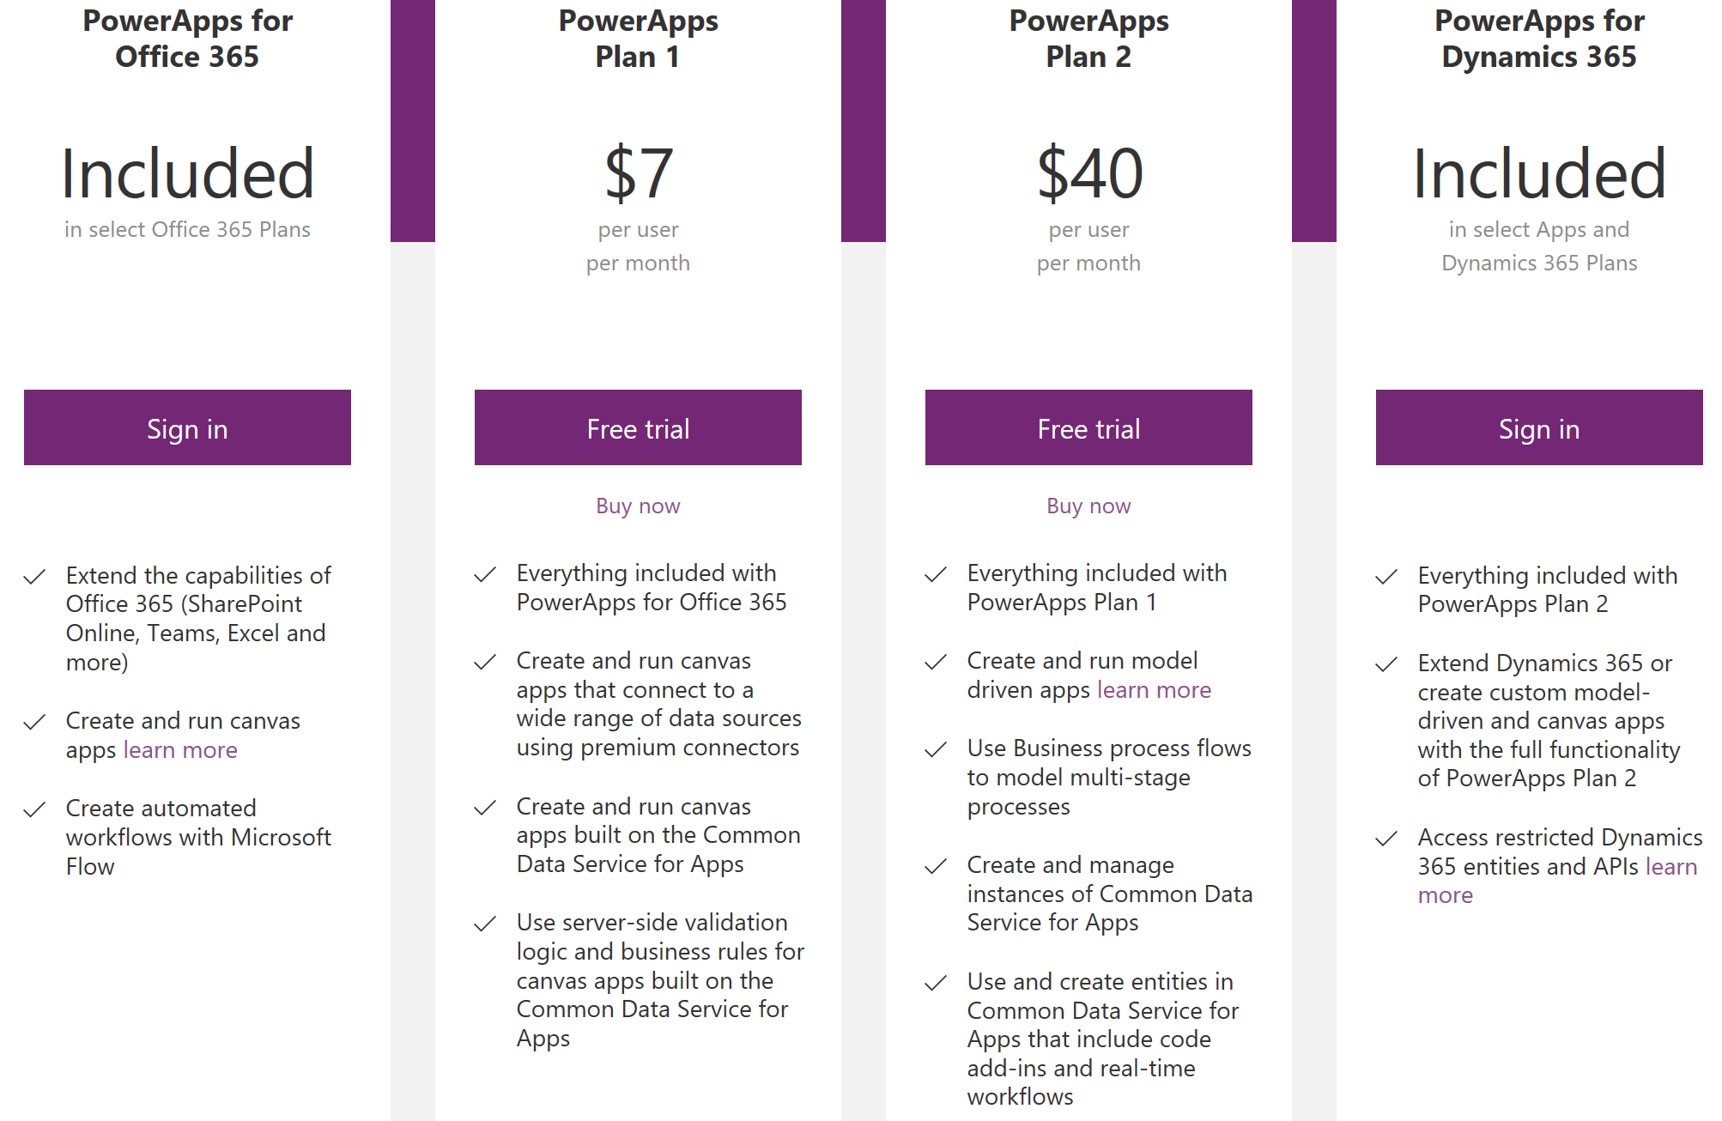
Licensing Nuances
https://powerapps.microsoft.com/en-us/pricing/
Notes:
Barb – Demo her contact app
Barb – Transition to all

Slide 52
Tips and Tricks
Notes:
Barb – Demo her contact app
Barb – Transition to all

Slide 53
Build Something - Tips & Tricks
Delegation - Server side vs. client slide processing for data queries.
Key Functions for Working with Data
Filter to create subset of data results (all contacts for an account).
Search for values in 1 or more columns.
Lookup fields returns first record to match (use to associate contact records to an account with GUID).
Sort ascending, descending or based on set of columns.
Know the data – Flow example with Boolean value.
Notes:
Karen/Bart/Barb
The filter function applies a formula to each record reducing an overall set of data down to a smaller subset that you can work with.
The search function allows you to search for a single string in one or more columns in the data source.
The lookup function, unlike filter which returns a subset of the data, lookup returns the first one that matches the formula that you pass.
And sort, just like it sounds, you'll use to order the data in ascending or descending order based on a set of columns.

Slide 54
Delegation - Understanding where query options are applied
Where the query options are applied can impact performance and actual results.
Many apps supports delegation of certain query options allowing them to be processed on the server instead of the client.
Server processing is the goal because it is more efficient and produces accurate results.
When server processing is not available for an option, the first 500 records that apply from the server are returned and then the client processing of the option occurs on that set of data (configurable from 1-2000 records).
Notes:
Karen/Bart/Barb
It's important to understand that if you are working with larger data sources, for example, if you had 10,000 contacts or any data source that has more than 500 records when you are working with Dynamics 365, it's important to understand where the query options that you are using will be applied.
So it's important to pay attention to this when you are building your filters and your searches to make sure that you have the queries running in an appropriate place or you are sure that you are processing less than 500 records. So Dynamics 365 supports what's referred to as delegation.
What that means is that it can decide to run the query filters that you have. So let's say I had status code equals 1, it could run that on the server-side meaning that it's processed on the server instead of pulling the data back and processing it on the client.
The reason that's important is if you pull back the data to the client, it's going to be a lot of overhead. So what they do is they only allow pulling back 500 records at a time to be delegated and processed on the client side. Whereas, if it's processed on the server, that is a much more efficient and produces much more accurate results.
The server processing is not available for some options.

Slide 55
Query options that ARE delegated to server
Not, IsBlank, <, <=, =, <>, >, >=, +, -, StartsWith
And (&&), Or (||), Not (!), In (recently included context variables)
Sort and SortByColumns are also performed on the server
Keep in mind, if the right side of the comparison includes a formula you might have to resolve the formula separately
E.g. createdon < Today()
Notes:
Karen/Bart/Barb
So if you are using Not, IsBlank, less than, greater than, equal, ands, ors, nots, those are all things that can be processed on the server as well as sort by columns are processed on the server. One thing that can get you into trouble is if you end up using a formula in your comparison.

Slide 56
Query options that are NOT delegated to server
If, ExactIn
*, /, Mod
Concatenate (including &)
String manipulation functions: Lower, Upper, Left, Mid, Len, ...
Signals: Location, Acceleration, Compass, ...
Volatiles: Now, Today, Rand, ...
Table shaping: AddColumns, DropColumns, ShowColumns, ...
Aggregates: Sum, Average, Min, ...
First, FirstN, Last, LastN
CountRows, CountA, Count
Collect, ClearCollect
CountIf, RemoveIf, UpdateIf
GroupBy, Ungroup
Notes:
Karen/Bart/Barb

Slide 57

How to tell if your query options aren’t delegated to server
Notes:
Karen/Bart/Barb
The blue squiggly line means that it will run on client and NOT server side.

Slide 58

Filtering Data
Filter function applies the formula to each record
Can include =,<>,<,>,>=,<=,&&,|| and In operators
Notes:
Karen/Bart/Barb
First thing that you are going to provide is the data source that you want to filter.
Example: filtering on contacts - then a comma - then the formula that I want to apply to that contacts data source.
You generally want the field from the data source on the left hand side of the formula that you are building to ensure it gets properly evaluated and handed off ideally to the server-side of for processing.
In this second one, filtering on parent customer ID, which I know from looking at the Dynamics 365 metadata that that is the parent customer that is associated with or the account that is associated with the contacts. What I'm saying is find me all of the accounts for this GUID.

Slide 59

Search
Search for a single text value in one or more columns
Notes:
Karen/Bart/Barb
Search is a great function to use where you want to allow a user to input some text and then find it in one or more fields.
This example - we have added a text box, text search box 1.
User to put in a phone number or a name or a last name.
Filtered that is on my Gallery that I'm going to show the list of items below that search box, I've bound items to instead of just binding it to contacts, which would show all of the contacts in that list
filtered that list by saying search contacts the field that has the data in it - search box 1.text comma and then the fields from the data source from contact.
First name, last name and telephone 1 - check to see if that phone number or name that you put in the search box is in any of those three fields
It will allow the record to pass and be shown in the search results.

Slide 60


Lookup
Find a single record and reduce it to all columns or a single value
Shows :
Shows :
Notes:
Karen/Bart/Barb
Lookup function allows you to do is resolve a formula down to a single record. Most common times you'll use this is dealing with relationships that exist in Dynamics 365.
Example: I used with contacts, we saw that it had a parent customer ID value field. That field has the GUID ID for the account entity and so in this case this record is related to Fourth Coffee.
If I were to have a field on the form where I simply show parent customer ID_value, all I'm going to show is the GUID, and they expect you to have the Fourth Coffee as the label for Account.
This is one of the things that they are looking at as an enhancement for the data sources to automatically include that label of the account name, but right now for when you have n to 1 relationship to a parent record, you do need to resolve that if you want to display the text value of the related record using the lookup function.
Use the lookup function, so we would say lookup open parentheses accounts, the data source you want to pull from because we know that is a lookup to that entity. Comma, account ID, that's the field that will store that GUID ID in the accounts entity equals parent customer ID value and what field that we want to return back (Nnme).

Slide 61
Sorting Data
Sort can sort by a simple formula e.g. numberofchildren + numberofexpectingchildren
Notes:
Karen/Bart/Barb
Example I have got sort contacts by number of children. Ascending is the default order if I don't specify a sort order for that. descending I would add on the sort order specification.
Example: use a simple formula.
if I had number of children plus number of expecting children that formula resulted in a number, a string or Boolean, you could sort and that value as well.
Sort by columns has the unique feature that you can also specify the order of the values that you want it sorted in. So instead of simply sorting it in ascending or descending order here for status code, what I'm saying is I want the 2s to be before the 1s or take an example where you have the days of the week, Monday, Tuesday, Wednesday, Thursday, Friday. Those don't sort ascending or descending based on a string order, but you could provide a list of those values on here and sort them in a logical day of the week sequence using the sort by columns.

Slide 62
Your Turn!
Or…
Notes:
Barb – Demo her contact app
Barb – Transition to all

Slide 63
LAB
Product Ordering App from CDS
Get instructions from http://aka.ms/appinaday
Notes:
Barb – Demo her contact app
Barb – Transition to all

Slide 64
LAB
Dynamics 365 Account Lookup
Get instructions from http://aka.ms/dynapp
Notes:
Barb – Demo her contact app
Barb – Transition to all

Slide 65

Functions for working with forms
SubmitForm – causes save to happen on new/changed data
NewForm – Sets a form up for creating a new record
EditForm – Sets the form into edit mode
ResetForm – reset the form the initial state e.g. cancel edits

Slide 66
Working with Dates
Now() returns current date/time
Today() returns current date with time set to midnight
Use DateAdd() to add or subtract days, months, years
Dynamics 365 stores dates in UTC, however they are adjusted depending on field metadata behavior setting
User local behavior date/time fields are handled
Time zone independent behavior date/time fields must be converted prior to save to UTC

